Slide 1

Blood Gene Expression as a Biomarker for Alzheimer's Disease Detection: A Review
M.Tech - Study Oriented Project Review
Guided by
Dr. Jothi R
Date : 20.02.2023
By
Hariharan J
22MCB1006

Slide 2
Abstract
Alzheimer's disease, a type of neurological condition, has seen an increase in the number of cases over the last decade, necessitating the development of a comprehensive method for early detection. Existing techniques are mostly invasive and expensive, so our research focuses on blood gene expression as a potential biomarker. The main challenge in analyzing blood gene expression data is the high dimensionality of the gene expression data. Consequently, this study investigates and summarizes the numerous feature selection and classifier techniques that can utilize blood gene expression data, as well as identifies the advantages of using blood gene expression data over other sources, such as MRI images and gene expression collected from other organs

Slide 3
Introduction
Alzheimer’s disease (AD) or also called as senile dementia is the most common type of dementia among humans.
AD is formally defined as the pathological deposition of folded beta-amyloid plagues, and hyper-phosphorylated neurofibrillary t au tangles in the brain leading to neurodegeneration [2].
Currently there is no cure exists for this, But early detection of the AD possibility will help to manage the control and temporarily improve the symptoms [3].
Gene Expression is an information which is stored in all our genes which are used for synthesis of a functional gene product which intern is used to produce end products like protein or non-coding RNA.
There are many studies carried out to find the genetic associations of AD through big data and statistical methods [4 - 5] and through Machine Learning (ML) models [6]. The major challenge of using ML models is the small sample size compared with the huge dimension of characteristic features.

Slide 4
Introduction – Cont.
Differential gene expression, commonly abbreviated as DG or DGE analysis refers to the analysis and interpretation of differences in abundance of gene transcripts within a transcriptome.
Lists of genes that differ between 2 sample sets are often provided by RNA sequence data analysis tools or can be generated manually by statistical testing of data sets.
Due to the large number of genes to be tested, (e.g., >20,000 in the human genome), multiple testing correction such as Bonferroni correction is usually applied.
Dataset | Samples | Probes
ADNI | 465 | 49386
ANM1 | 329 | 38329
ANM2 | 388 | 32049

Slide 5
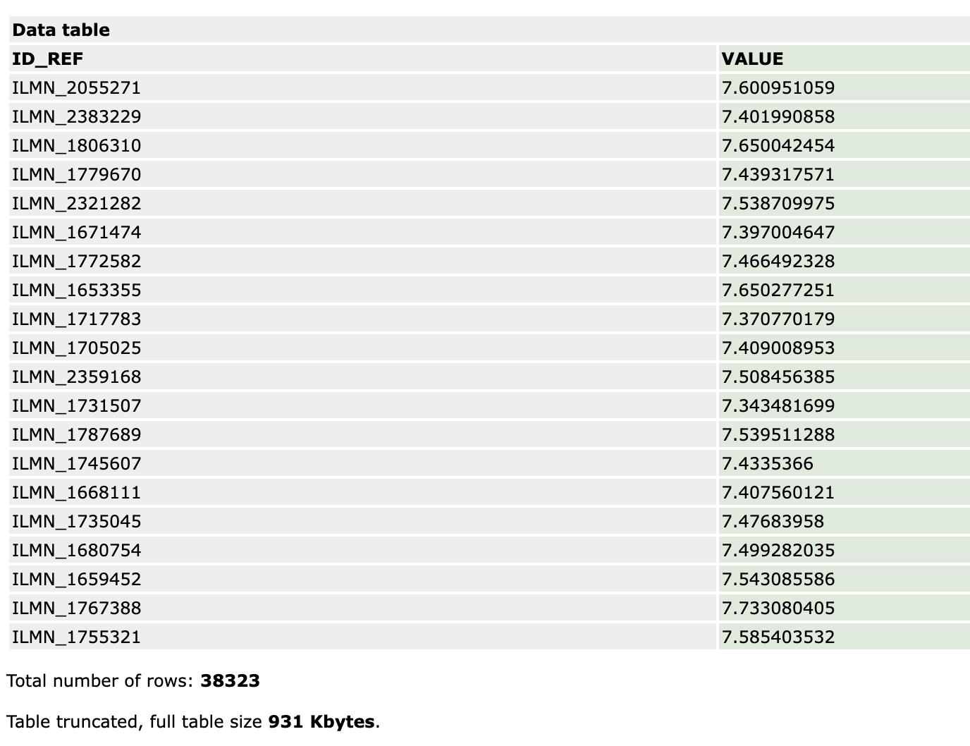
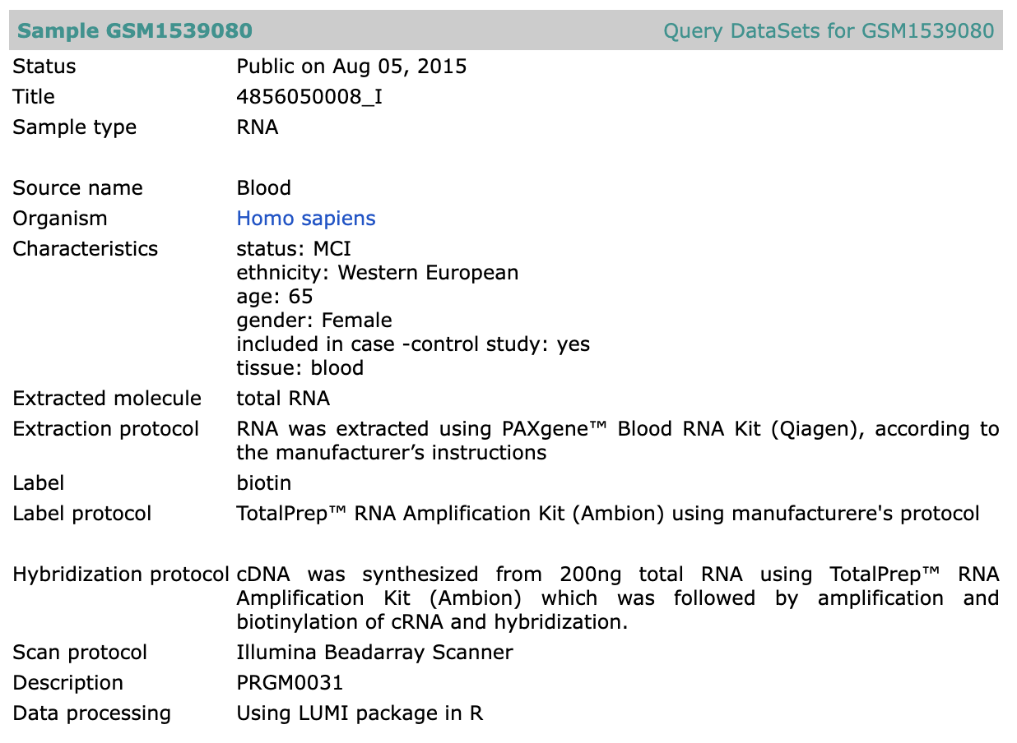
Dataset

Slide 6
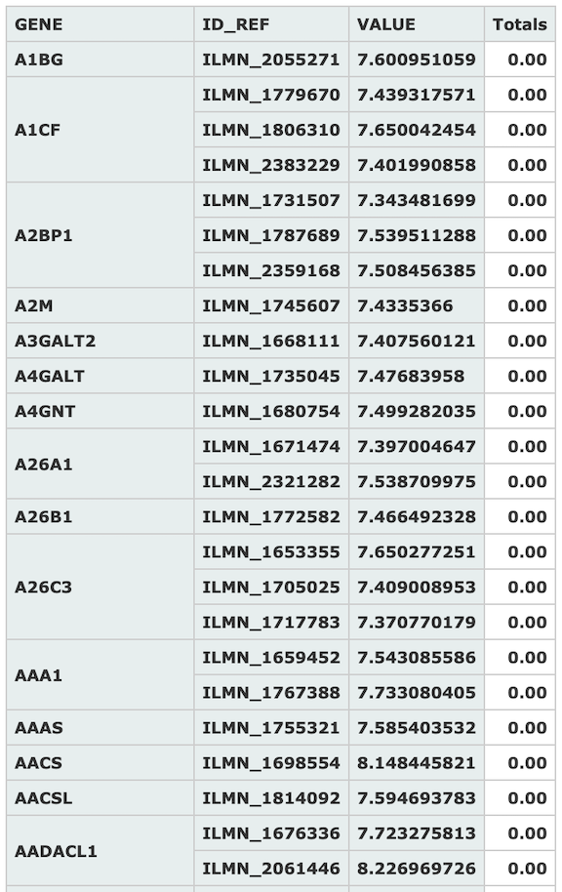
Gene Expression
Summary of blood gene expression values of top 15 Gene symbols measured against different probe identifiers taken from sample GSM1539080 which was measured as part of dataset GSE63060

Slide 7

Motivation
Primary objective is to find the best algorithm to extract the genes from blood gene expression that influence the possibility of Alzheimer’s.
Secondary objective is to find the best algorithm which can classify using the DEG the possibility of Alzheimer’s.

Slide 8

Literature Survey

Slide 9
Study | Dataset Used | Feature Selection Alg. | No. of Genes | Classification Alg. | Performance
Lee, T et al. | GSE3060, GSE3061 | SAM | 697 | SVM | AUC: 87.4%
M. S. Kamal et al. | GSE174367 | - | 18,234 | KNN SVM | ACC: 64.5% ACC: 82.4%
Mahendran, N et al. | GSE76105 | Adaboost | 12 | DRNN | ACC: 89.4%
S. Khanal et al. | ADNI | t-test + SelectFromFeature | 25 | XGBoost | ACC: 65% AUC: 67%
El-Gawady, A et al. | GSE33000 GSE44770 GSE44768 GSE44771 | χ², ANOVA, MI | 30 | SVM | ACC: 97.5% AUC: 97.2%
S. Perera et al. | GSE5281 | PCA, RF, ETC | 14 | SVM | ACC: 93.9%
C. Park et al. | GSE33000 GSE44770 GSE80970 | t-test | 35 | DNN | ACC: 82.3%
H. M. AL-Bermany et al. | GSE3060 GSE3061 | ANOVA + k-means | 2500 | CNN | ACC: 92.9%
A. Sharma et al. | GSE33000, GSE44770 GSE118553, GSE1132903 GSE5281, GSE48350 GSE28146, GSE5281 GSE48350, GSE4757 | varSelRF + LASSO | 208 | ElasticN | ACC: 0.98
Kalkan H et al. | GSE63060 GSE63061 GSE140829 | LASSO | 488 | CNN | ACC: 84.2% AUC: 87.5%
D. Sun et al. | GSE5281, GSE44771, GSE109887, GSE132903 | RF | 6 | DNN | ACC: 92.3%
Table 1: Summary of studies conducted on detection of AD using various feature selection and classification techniques with gene expression.

Slide 10
Study | Dataset | Classification Alg. | Accuracy
S. Pavalarajan et al. | OASIS | RF | ACC: 83.50%
S. S. Rajeswari et al. | ADNI | VGG-19 | ACC: 98.00%
J. Li et al. | ADNI | 3-D U-Net CNN | ACC: 95.06%
S. Basheer et al. | OASIS | CapNet | ACC: 92.39%
G. Chutani et al. | Kaggle | VGG-16 + SVM | ACC: 99.33%
D. Chaihtra et al. | Kaggle | DenseNet121 | ACC: 96.00%
U. R. K et al. | Kaggle | GLCM + SVM | ACC: 84.00%
S. Buyrukoğlu et al. | ADNI | Stacked Ensemble | ACC: 91.20%
Table 2: Summary of studies using biomarkers other than gene expression

Slide 11
Prediction of Alzheimer’s disease using blood gene expression data, Lee, T., Lee, H - Nature, Sci Rep 10, 3485 (2020)
This study was done one three public datasets ADNI, ANM1, ANM2 and feature selection method such as Variational Auto Encoder (VAE) and five classifiers (LR, L1-LR, SVM, RF, DNN) were used compile the gene related to AD and classify AD samples from healthy control (CN) samples.
Internal validation by five-fold cross-validation within each dataset was done and external validation was done with training and test sets from different datasets
Validation | Dataset | Accuracy
Internal | ADN1 | 66%
 | ANM1 | 87%
 | ANM2 | 80%
External | ADN1-ANM1 | 70%
 | ADN1-ANM2 | 76%
External | ANM1-ADN1 | 62%
 | ANM1-ANM2 | 79%
 | ANM2-ADN1 | 66%
 | ANM2-ANM1 | 86%

Slide 12
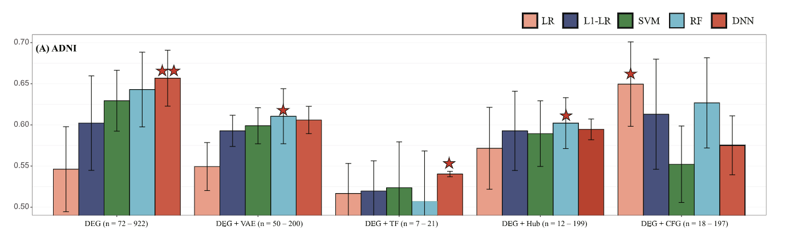
Proposed Method:
Data Preprocessing
Ignoring gene expression less than the median value which where (3.897, 7.584, 6.154) for the three datasets and after than select only the probes common in all three data set.
Normalize each dataset.
Feature extraction
Use VAE to represent the input as input dimension is huge.
Extract the TF related genes [7]
Classification
Employ LR, L1-LR, SVM, RF, DNN
Result / Validation
Internal and External Validation

Slide 13
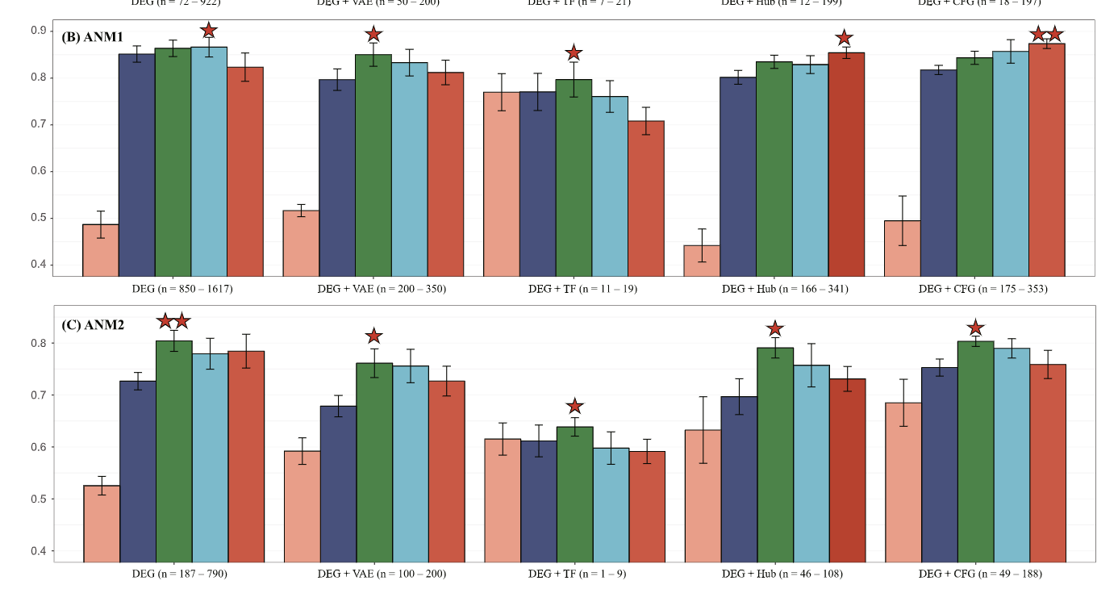

Slide 14
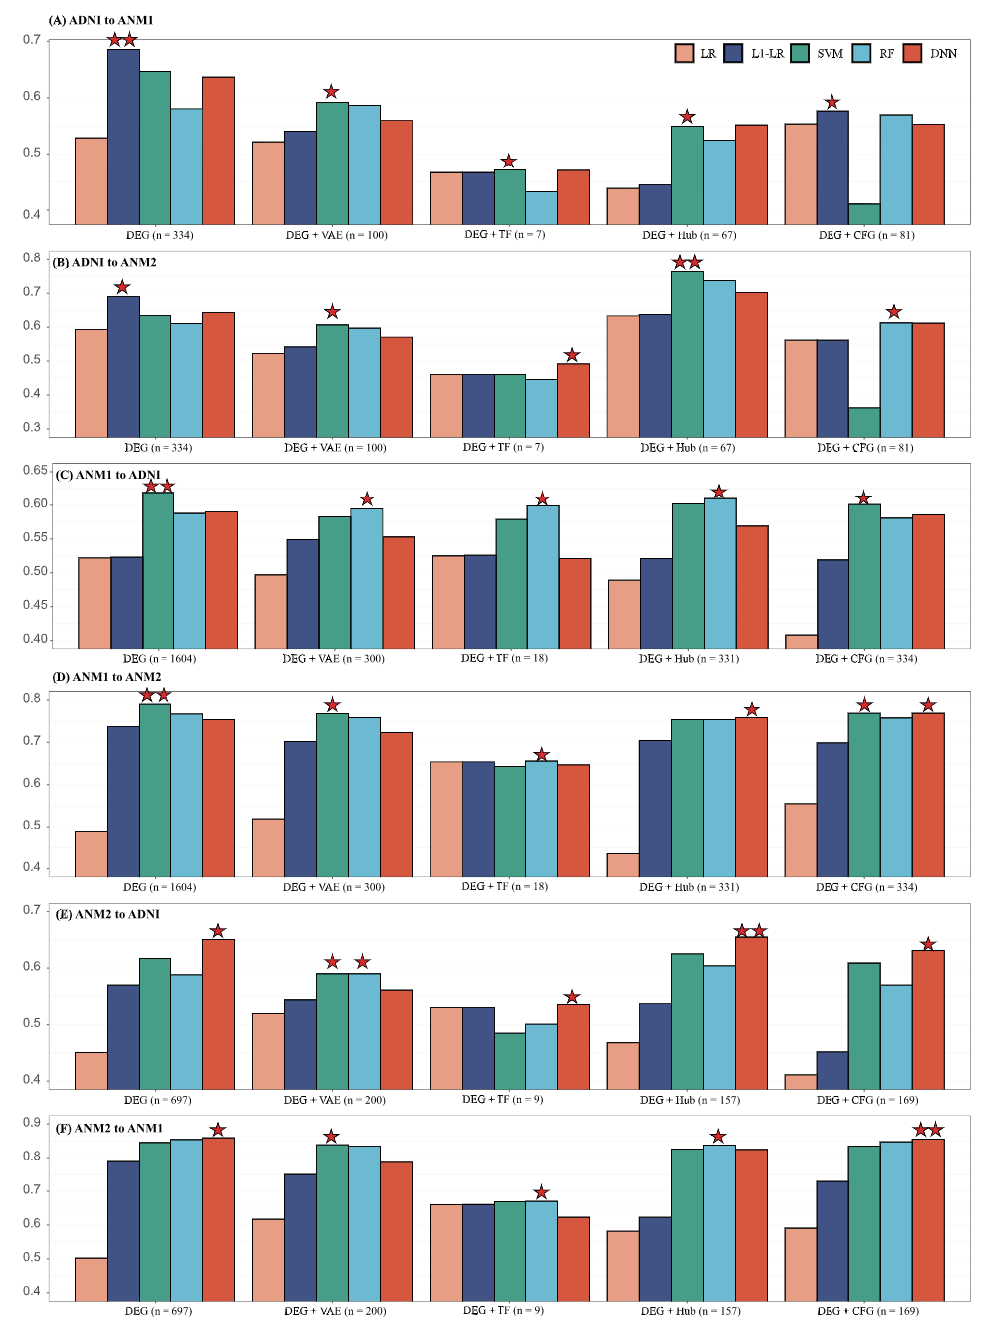

Slide 15
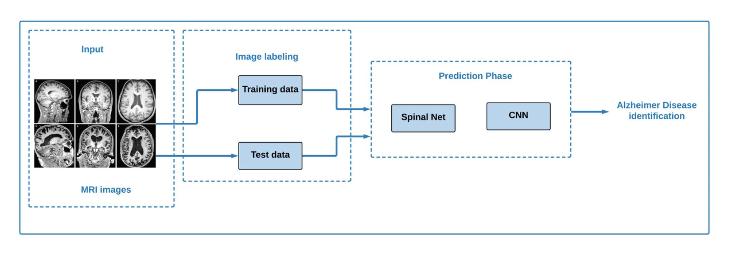
Alzheimer’s Patient Analysis Using Image and Gene Expression Data and Explainable-AI to Present Associated Genes, M. S. Kamal, A. Northcote, L. Chowdhury, N. Dey, R. G. Crespo and E. Herrera-Viedma - IEEE Transactions on Instrumentation and Measurement, vol. 70, pp. 1-7, 2021, Art no. 2513107
In this study first, SpinalNet and convolutional neural network (CNN) is used to classify AD from MRI images. Then microarray gene expression data to classify the diseases k-nearest neighbours (KNN), support vector classifier (SVC),and Xboost classifiers.
Most the algorithms approaches use only either image or gene expression, while in this they have used both the data together and explained the results using trustworthy methods by using explainable artificial intelligence (XAI).
Fig : Proposed method to classify using MRI

Slide 16
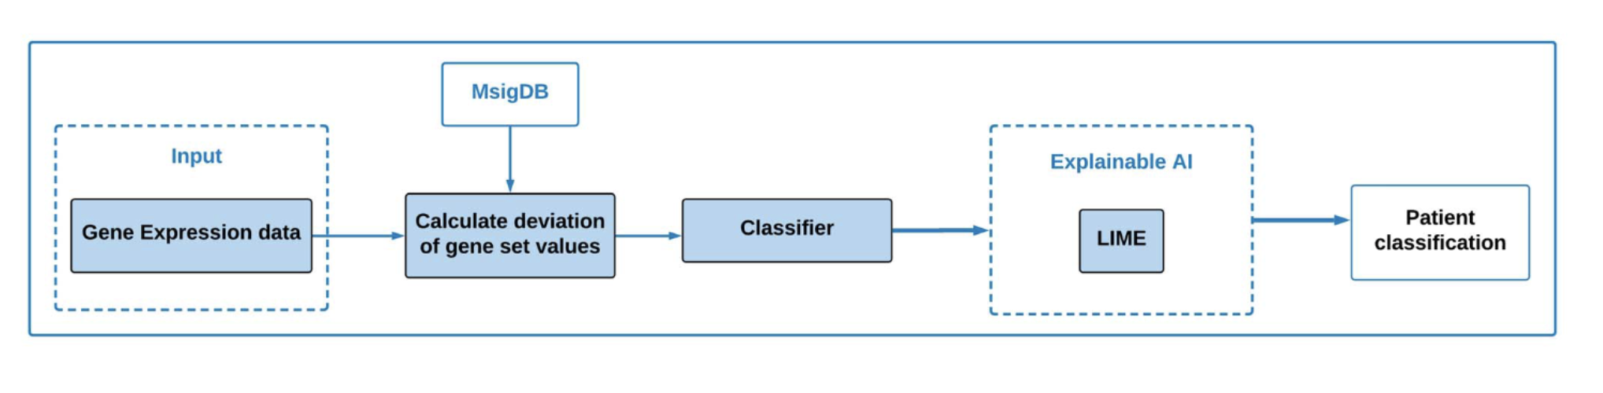
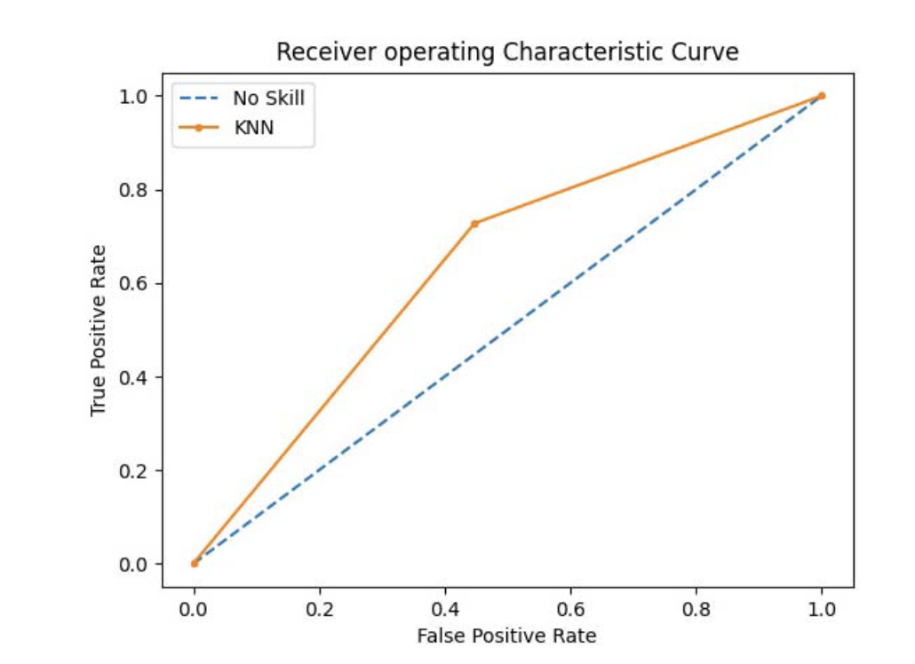
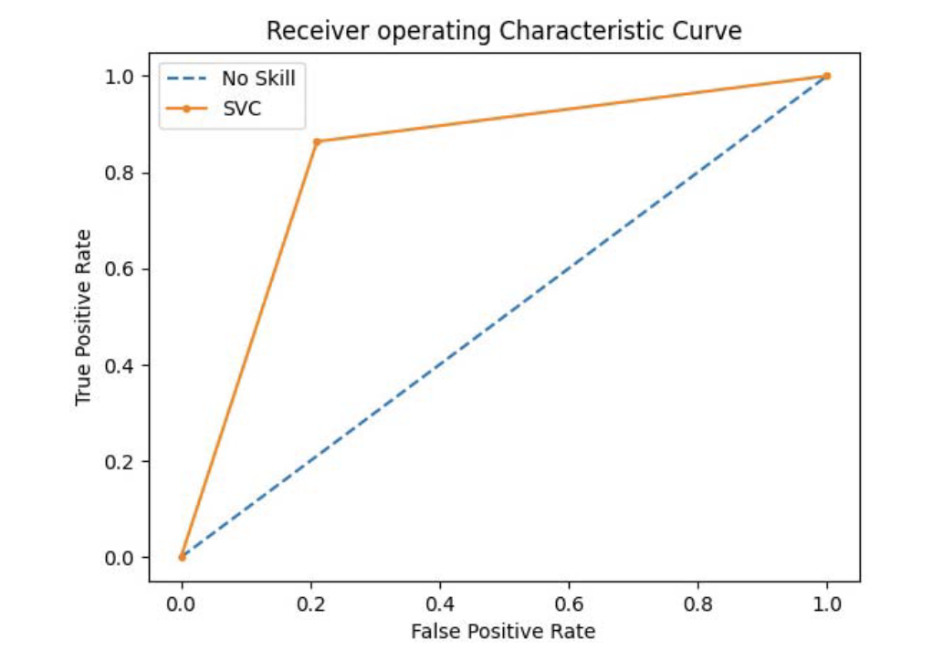
Fig : Proposed method to classify using gene expression
Fig : ROC curve of KNN
Fig : ROC curve of SVC

Slide 17
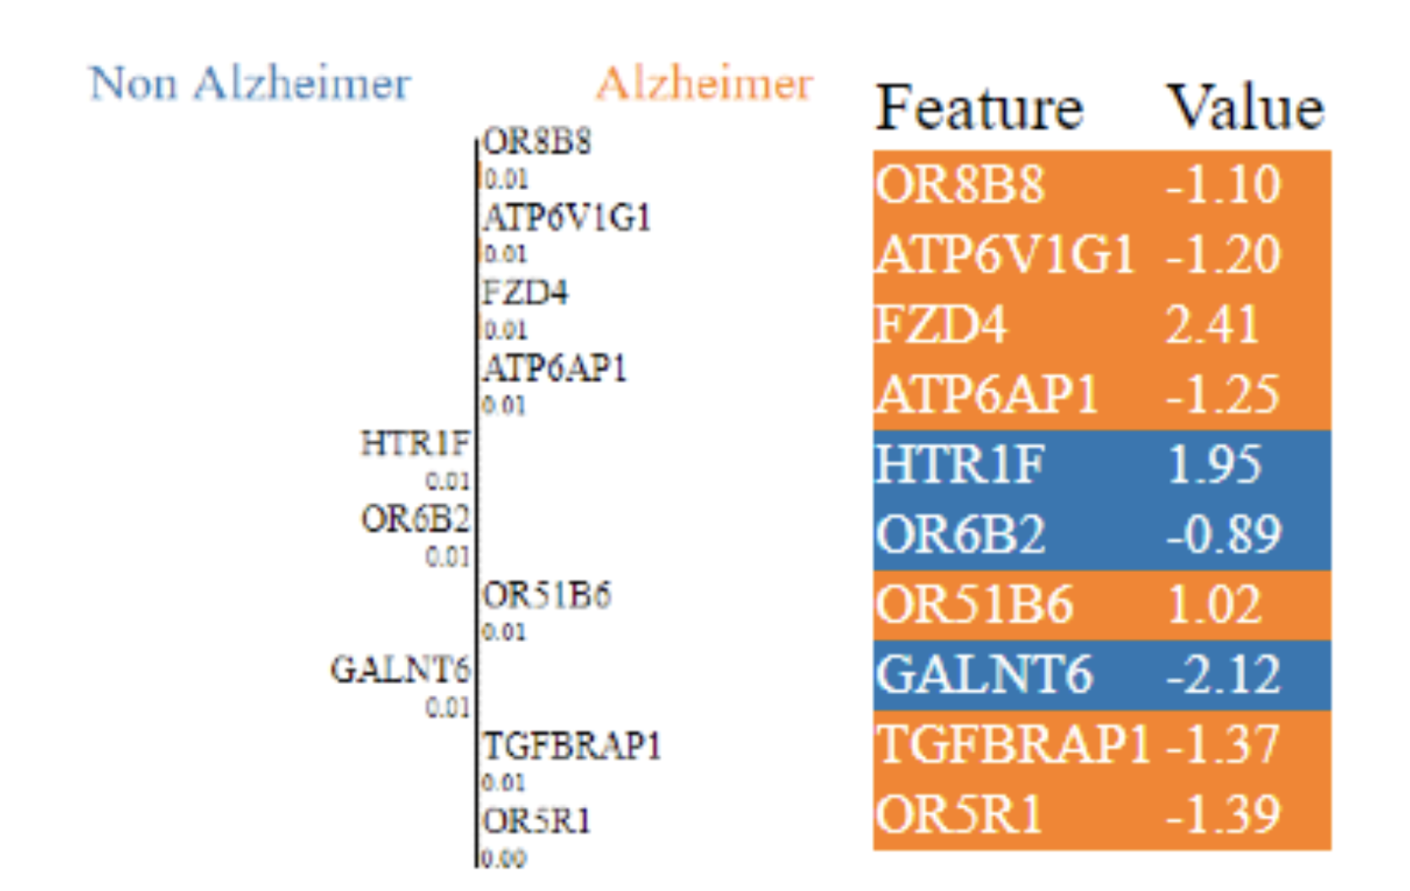
Outcome of XAI
LIME mechanism was used to make the output of the classifier more interpretable.
Genes like OR8B8 and ATP6V1G1 were found to the highly significant genes for AD

Slide 18
A deep learning framework with an embedded-based feature selection approach for the early detection of the Alzheimer’s disease, Nivedhitha Mahendran, Durai Raj Vincent P M - Elsevier, Computers in Biology and Medicine, Volume 141,2022
This study was to provide early diagnosis of AD using embedded feature selection process. An AD DNA methylation [8] data set having 34 AD samples and 34 heath control samples were used from GEO omni bus repository. Four embedded feature selection models were used along with Enhanced Deep Recurrent Neural Network (EDRNN), DRNN, CNN, RNN.
Dataset: GSE76105 from GEO Omnibus repository is used.
Proposed Method :
Pre-processing : eliminate poor samples based on the p-value.
Normalize the data.
Embedded Feature Selection : LASSO (Least Absolute shrinkage and selection operator), SVM, AdaBoost, Random Forest.
Classification : RNN, CNN, DRNN, EDRNN

Slide 19
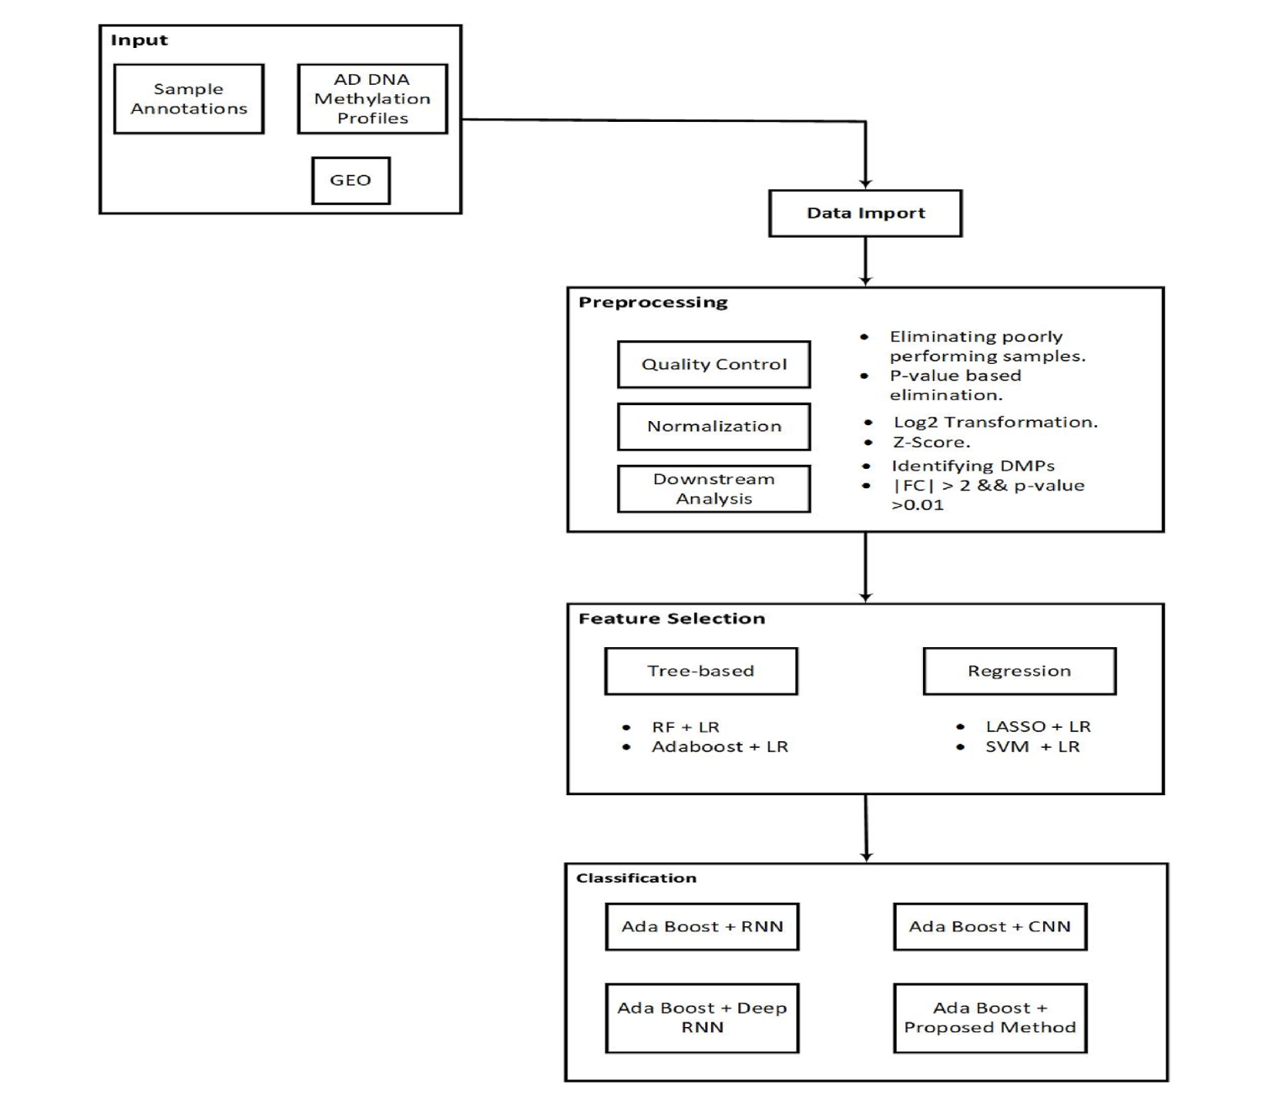
Fig : proposed method

Slide 20
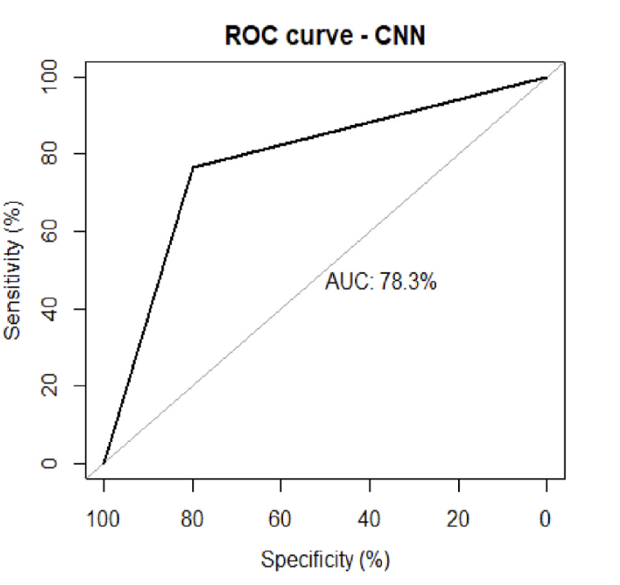
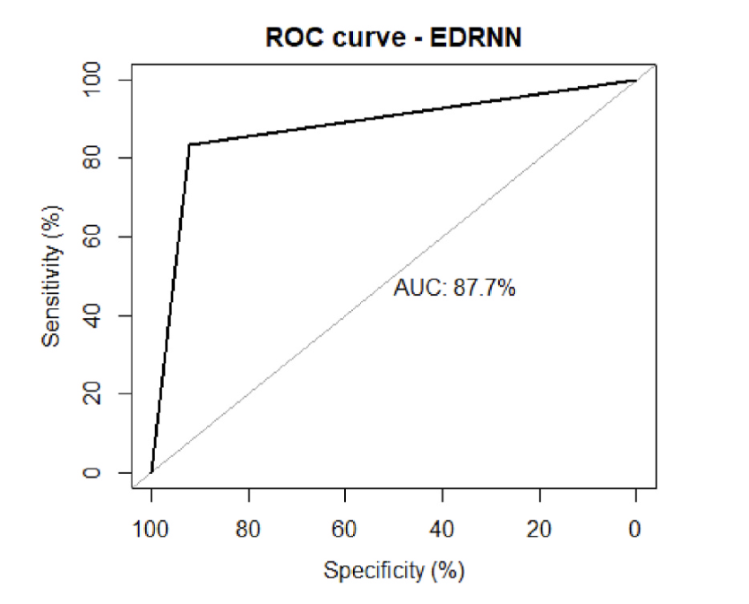
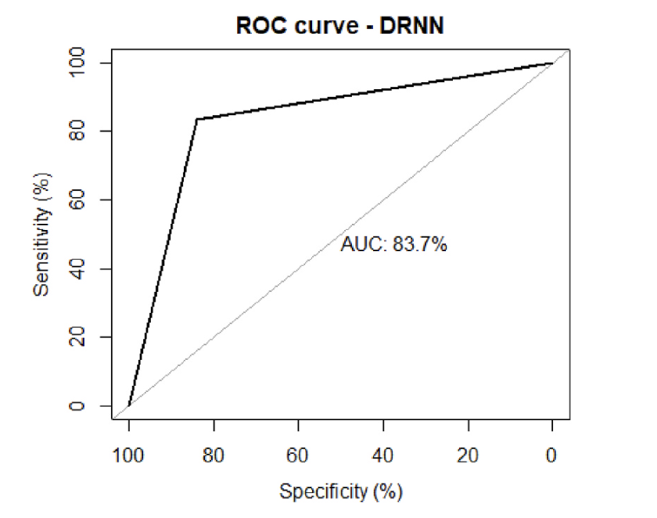
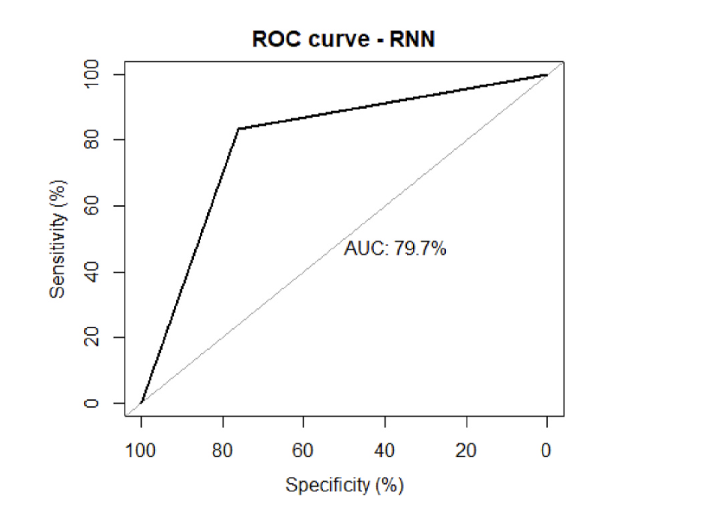

Slide 21
Alzheimer’s Disease Classification Using Genetic Data, S. Khanal, J. Chen, N. Jacobs and A. -L. Lin, IEEE International Conference on Bioinformatics and Biomedicine (BIBM), 2021, pp. 2245-2252
In this study separately the potential of the blood gene expression data as well as the Single Nucleotide Polymorphism (SNP) data in building ML models for AD classification is analysed.
A systematic approach on feature selection and ML model design using both types of genetic data provided by the Alzheimer’s Disease Neuroimaging Initiatives (ADNI).
Two-step feature selection produced a curated list of important genes. In addition to these selected genetic features, to examine the role of non-genetic covariates, Age and number of education years (EDU) as extra features are included.
Feature | Included additional Feature | AUC
Gene Expression | No | 64%
 | Yes | 65%
SNP | No | 56%
 | Yes | 64%

Slide 22
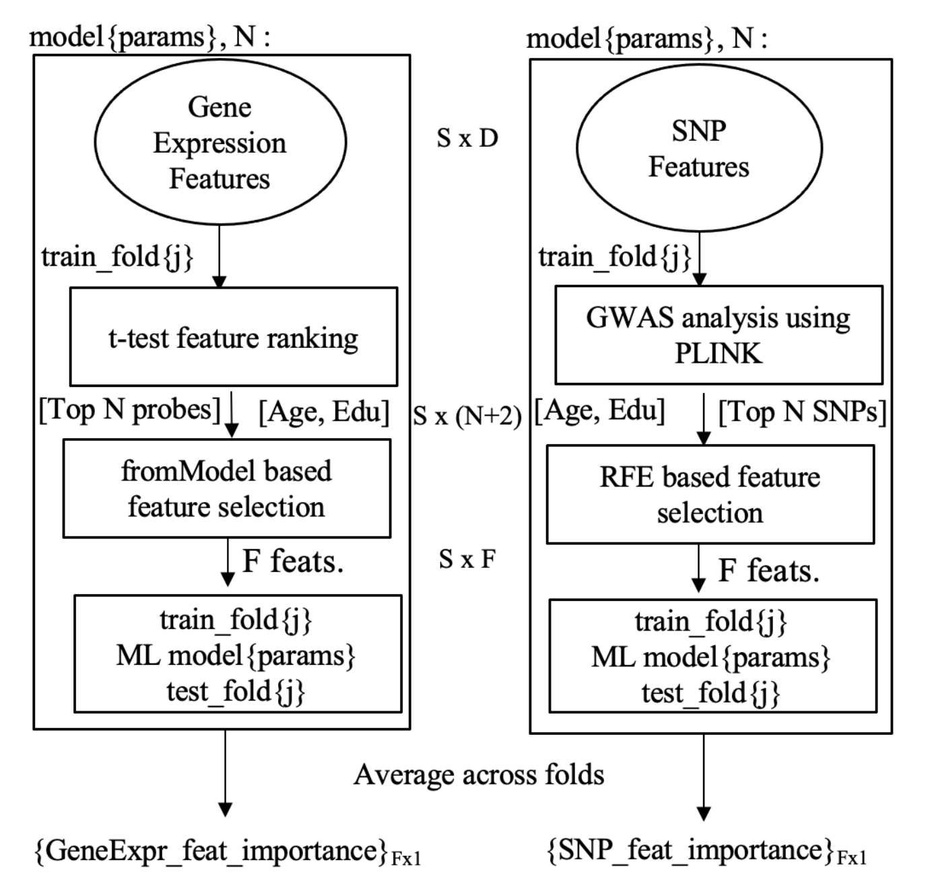
Model Training on Gene Expression
t-test carried out between the groups of genes
Feature selection from the N genes selected from the above step (Recursive feature elimination used (RFE))
Added additional features to improve model performance XGBoost classifier
Model Training on SNP data
Similar step as for gene expression used.
Feature selection algorithms like LR is performed using tool PLINK [9]
Added additional features to improve the performance of Model.

Slide 23
Machine Learning Framework for the Prediction of Alzheimer’s Disease Using Gene Expression Data Based on Efficient Gene Selection, El-Gawady, A., Makhlouf, M. A., Tawfik, B. S., and Nassar, H. - Symmetry - vol. 14, no. 3, p. 491, 2022
This study is intended to introduce a symmetric framework to predict AD from Gene Expression (GE) data, with the aim to produce the most accurate prediction using the smallest number of genes.
The framework works in four stages after it receives a training dataset: pre-processing, gene selection (GS), classification, and AD prediction.
The symmetry of the model is manifested in all of its stages. In the pre-processing stage gene columns in the training dataset are pre-processed identically.
In the GS stage, the same user-defined filter metrics are invoked on every gene individually, and so are the same user-defined wrapper metrics.
In the classification stage, a number of user-defined ML models are applied identically using the minimal set of genes selected in the preceding stage.
Sensitivity | Specificity | precision | Kappa index | AUC | accuracy
97% | 97% | 98% | 0.945 | 97.2% | 97.5%

Slide 24
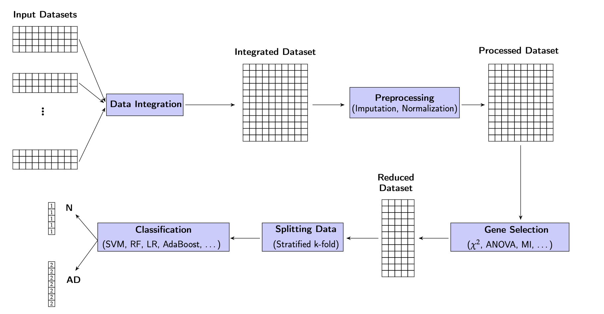

Slide 25
Chi squared
χ2 is a well-known statistical metric used to examine the dependence between two random variables, in this situation a gene and the target output, which is the case diagnosis, AD or N.
Analysis of variance
Analysis of variance (ANOVA) is a powerful family of techniques to test the significance of the difference between the means of two random variables. In this situation, the two variables are a gene and the target output, which is the case diagnosis, AD or N
Mutual information
mutual information I(X, Y) which measures the shared information between two random variables X and Y. In our situation, the two variables are a gene and the target output, which is the diagnosis, AD or N.

Slide 26
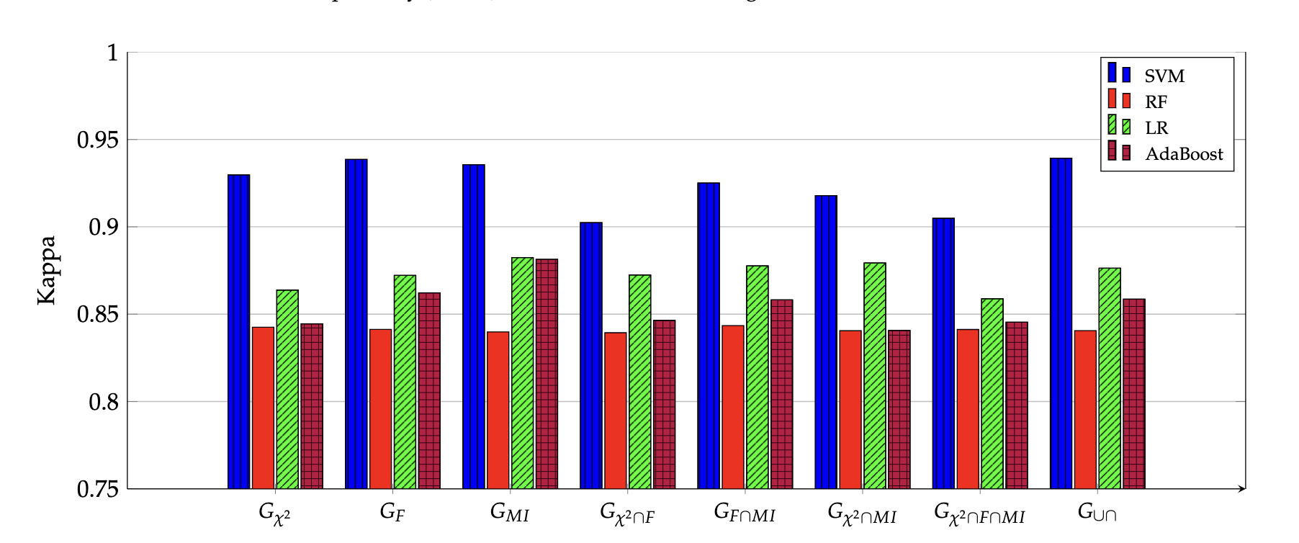
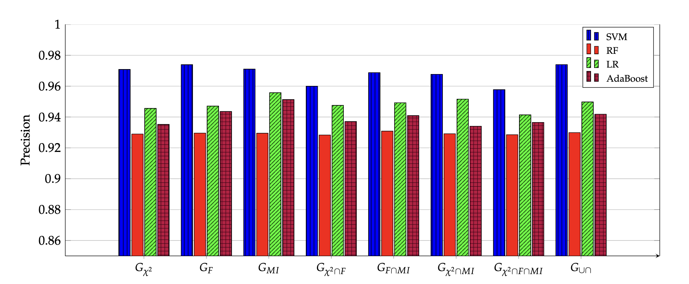
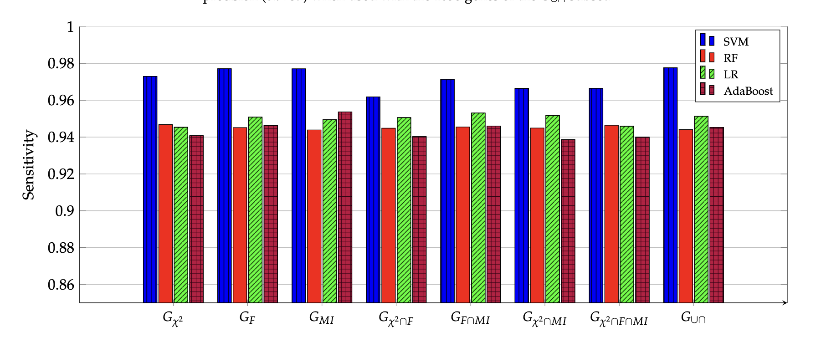
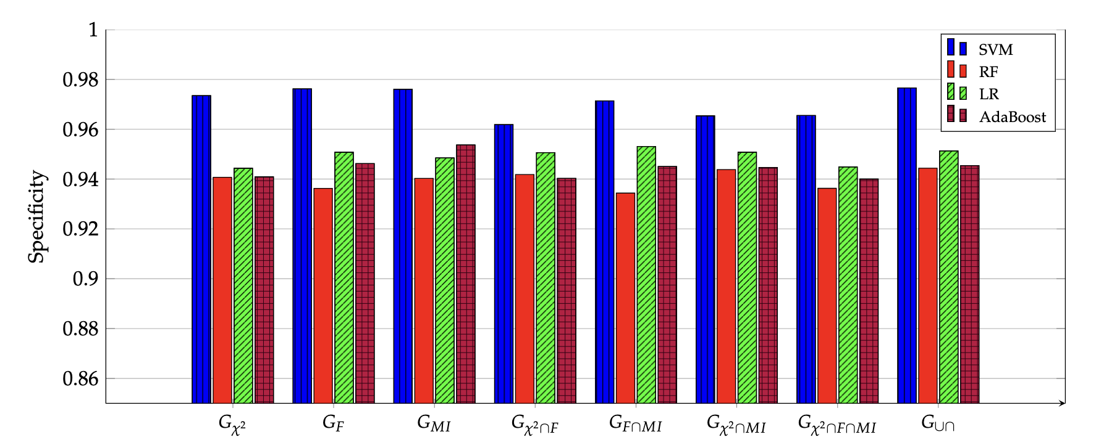

Slide 27
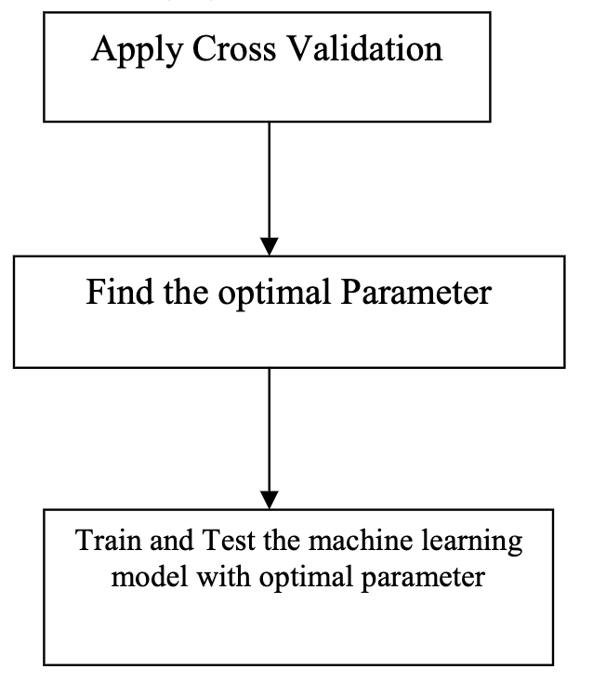
Detection of Alzheimer’s disease at Early Stage using Machine Learning, S. Pavalarajan, B. A. Kumar, S. S. Hammed, K. Haripriya, C. Preethi and T. Mohanraj - IEEE International Conference on Advanced Computing Technologies and Applications (ICACTA), 2022
This study explores the classification algorithms including logistic regression, support vector classifier, decision tree, and random forest classifier. The models are fine tuned by choosing optimal values for parameters that influences the accuracy of the model.
The optimal parameters are found using a K-fold cross validation score, and the models are generated using that.
The dataset used in the model is longitudinal cross-sectional data from OASIS. It has been inferred from the results that random forest classifier performs well than the other models.

Slide 28
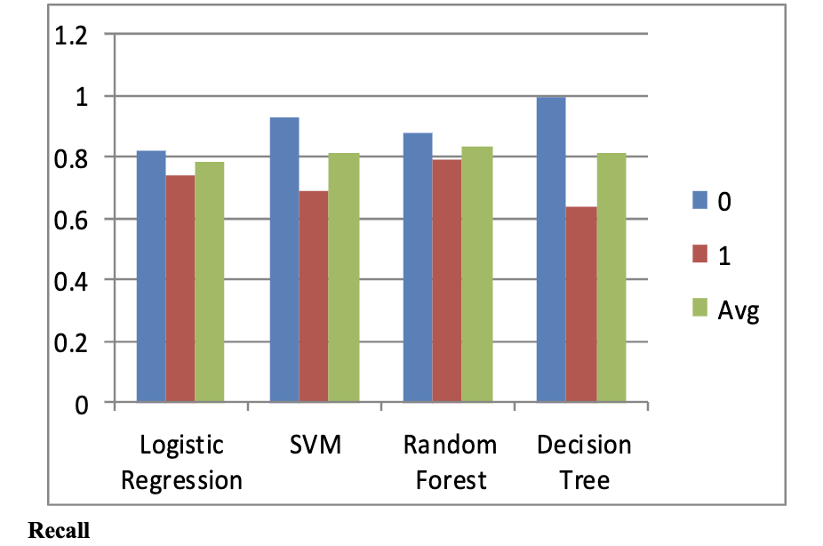
Data Pre-Processing
Handling missing data
Feature scaling
Train test split
Machine Learning Model
Logistic Regression
Support Vector Machine
Decision tree
Random Forest

Slide 29
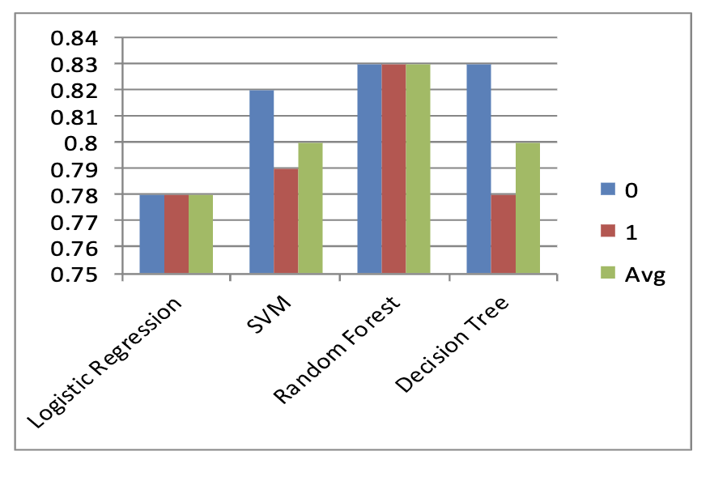
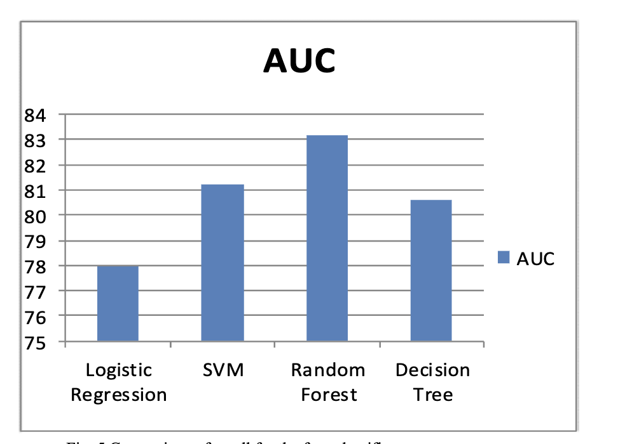
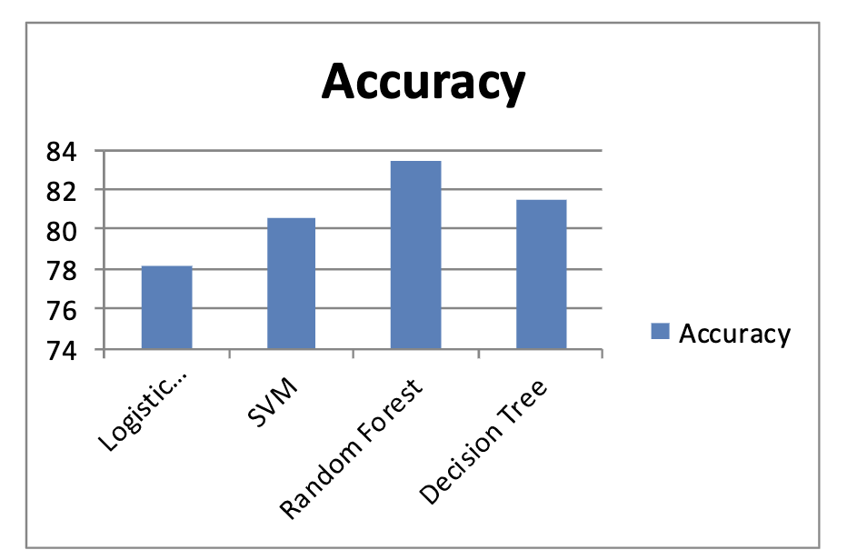

Slide 30
A Transfer Learning Approach for Predicting Alzheimer’s Disease, S. S. Rajeswari and M. Nair - IEEE Biennial International Conference on Nascent Technologies in Engineering (ICNTE), 2021, pp. 1-5
In this study, the potency of transfer learning approach was analysed in detail by fine tuning the deeper layers of Transfer Learning models like VGG-19, VGG-16, Resnet-50 and Xception.
In prior work, VGG-16 model was experimented on the ADNI datasets to get an accuracy of 97% and a precision of 96%.
From this study, it is analysed that the overall classification accuracy and precision of VGG- 19 is exceptionally high (98%) when compared to other models.
This shows that the automated method can be a true guide in Alzheimer’s detection and prediction, especially when an early-stage diagnosis may help to get the benefit of treatment.

Slide 31
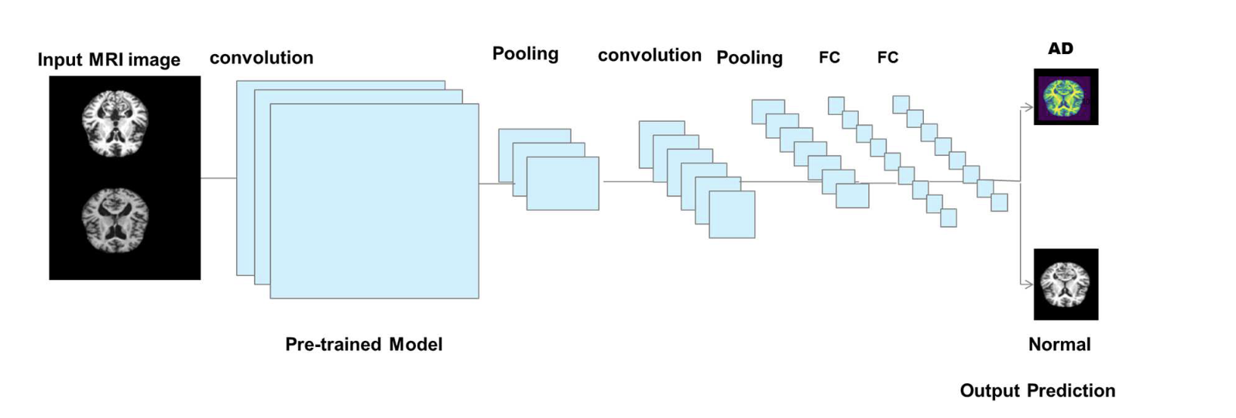
Transfer Leering Model
A pre-trained model is reused by freezing the dense layers or the final layer to train a complex or a large model.
Models such as VGG-19, VGG-16, ResNet-50 and Xception are explored and Xception found to the one with better accuracy.

Slide 32
Detection of Novel Biomarker Genes of Alzheimer’s Disease Using Gene Expression Data, S. Perera, K. Hewage, C. Gunarathne, R. Navarathna, D. Herath and R. G. Ragel, IEEE Moratuwa Engineering Research Conference (MERCon), 2020, pp. 1-6
This study was conducted to understand the underlying mechanism and the pathogenesis of the Alzheimer’s disease.
Underlying genetic structure of the disease, gene expression data were used to identify possible genes that are risk.
A machine learning framework that can be used to identify possible bio-marker genes is proposed.
Discovered possible set of 14 genes are validated by biological sources.
Model | Testing | Training
Random Forest | 83.67% | 87.48%
SVM + Gaussian Kernel | 83.67% | 91.06%
SVM + Linear Kernel | 89.80% | 93.76%

Slide 33
GSE5281 gene dataset is used to present a critical analysis of the proposed machine learning framework.
Method:
Data Pre-processing: Extracting 24,438 unique gene symbols from 161 samples with 87 diagnosed with Alzheimer’s.
Differently Expressed Genes: t-test done to extract the p-value for each gene and gene rejected having pValue < 0.05.
Feature Selection: using PCA top 50 genes are extracted. PCA (Principal Component Analysis) is technique which uses set of orthogonal transformation to reduce the feature size. RF is also used to cross validate.
Classification: following classification were used
Naïve Bayes
Decision Trees
Radom Forest
Nearest Neighbor
SVM with linear and gaussian kernel

Slide 34
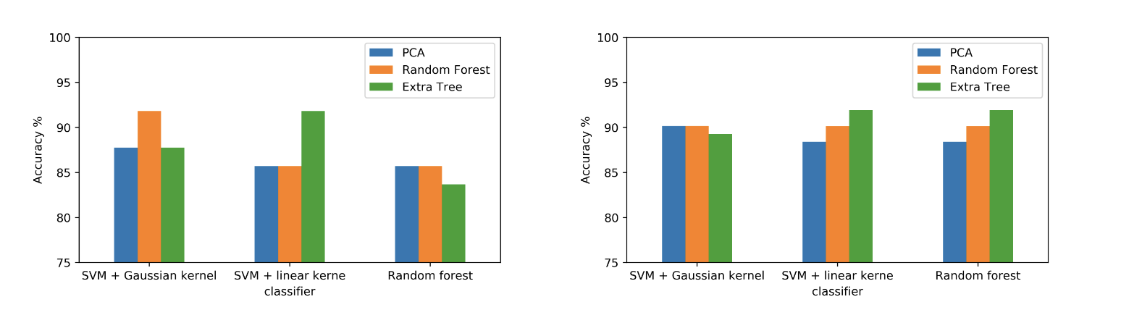
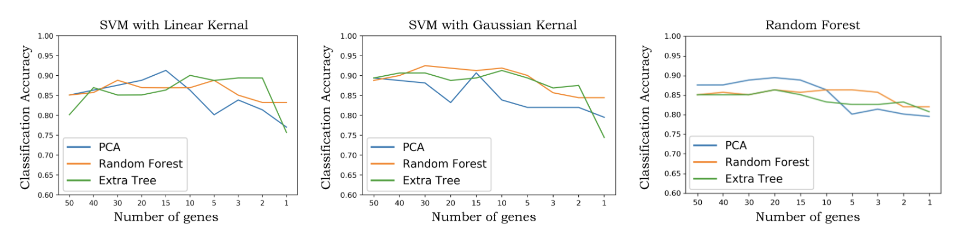
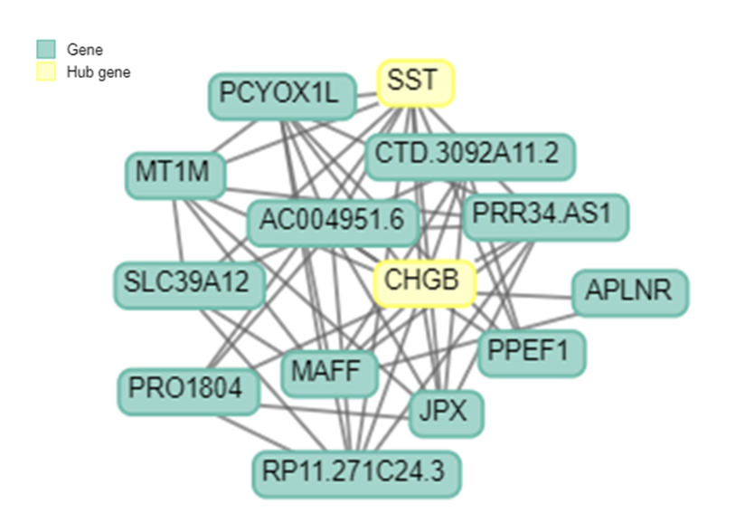

Slide 35
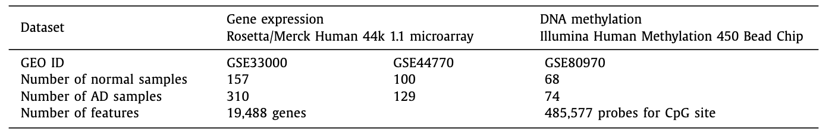
Prediction of Alzheimer’s disease based on deep neural network by integrating gene expression and DNA methylation datasets, Chihyun Park, Jihwan Ha, Sanghyun Park - Elsevier, Expert Systems with Applications, Volume 140, 2020,
This study is performed to explore gene expression extracted from brains prefrontal cortex for early detection of Alzheimer’s rather relying on the conventional way of detection using brain images using MRI’s.
Involves selection of differently expressed gene and differently expressed methylated position in multi omnics dataset.
Showcases integration of gene expression data and DNA methylation data.
Feature selection and Prediction model seen to be outperformed the existing conventional machine learning algorithms.

Slide 36
Method:
Dataset: GSE33000 and GSE44770 were used from GEO Omnibus for gene expression data and GSE80970 were used for DNA methylation profiles.
Feature Selection: Does not consider traditional feature reduction algorithms PCA, instead use LIMMA packages which is based on t-test.
Prediction Model:
SVM
Naïve Bayesian
Random Forest
DNN
These were also verified with k-fold cross validation.

Slide 37
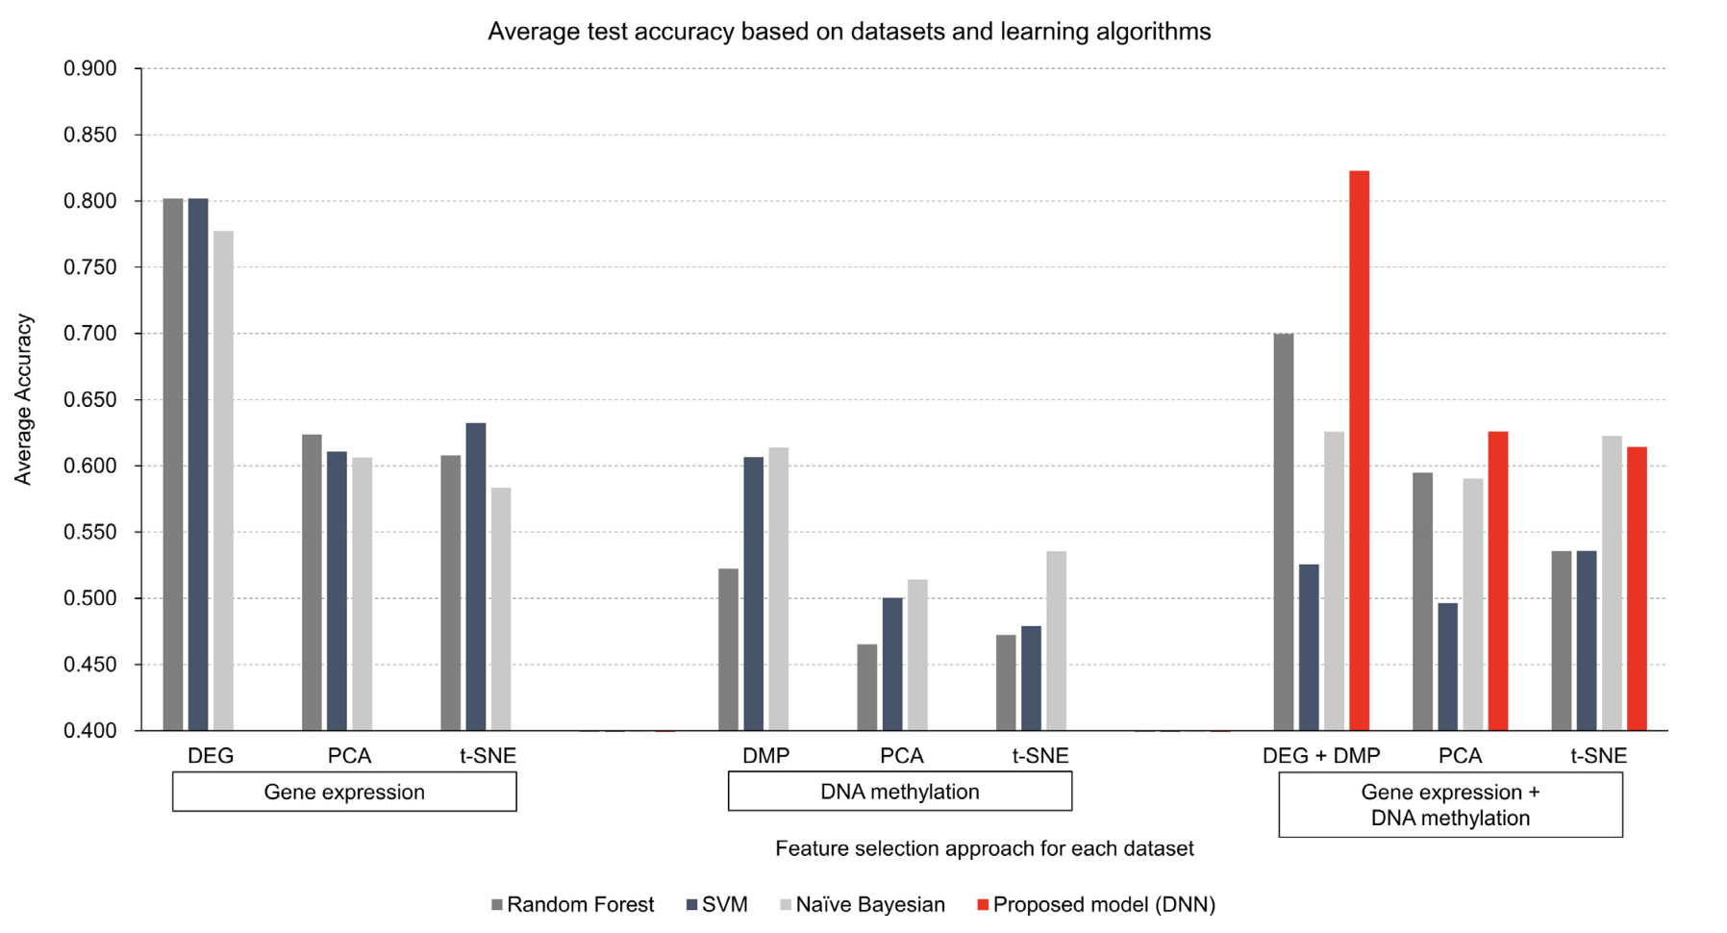

Slide 38
Microarray Gene Expression Data for Detection Alzheimer’s Disease Using k-means and Deep Learning, H. M. AL-Bermany and S. Z. AL-Rashid – IEEE 7th International Engineering Conference “Research & Innovation amid Global Pandemic" (IEC), 2021, pp. 13-19
This study aims to identify the most important genes that causes the Alzheimer’s disease by using feature(gene) selection to reduce the high dimensional data size
Two-fold approach, first to remove the irrelevant features and second to predicting the AD patients.
Statistical methods are explored for Gene Selection and CNN (Convolutional Neural Networks) along with K-Means is explored for classification.
Feature Selection | Prediction Method | Accuracy
ANOVA | K-means with CNN | 92.9%
MI | K-means with CNN | 88.6%

Slide 39
Method:
Dataset: from GEO Omnibus the following were used, GSE63060 and GSE63061. These have 16382 gene symbols and 569 samples, out of which 245 are samples are of AD patients.
Preprocessing: Noise removed and did batch normalization using Min-Max normalization.
Gene Selection:
ANOVA
MI (Mutual Information)
Prediction:
K-Means clustering: employed to reduce D genes from N samples to K.
CNN: Output from previous used for classification. 3 Convolution layers and 3 MaxPooling layers.

Slide 40
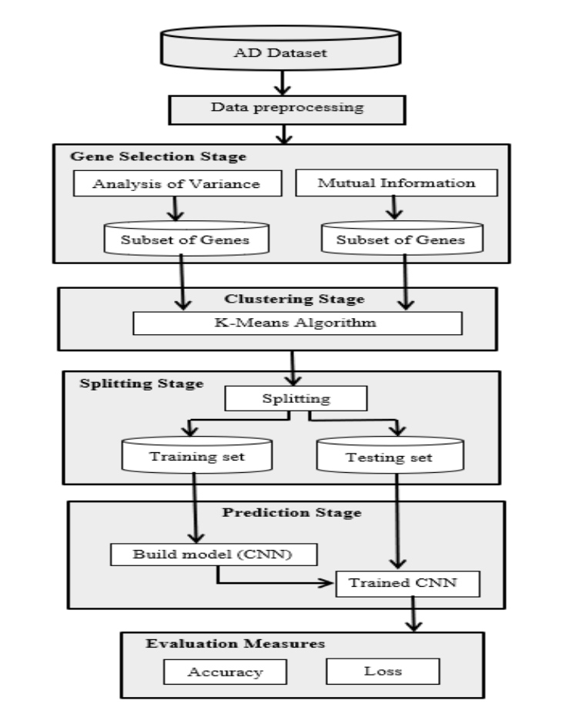
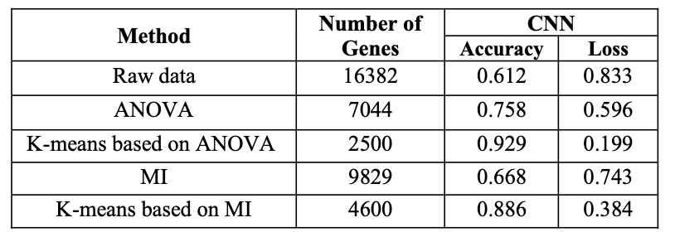

Slide 41
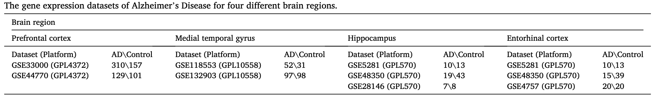
A machine learning approach to unmask novel gene signatures and prediction of Alzheimer’s disease within different brain regions, Sharma A, Dey P– Elsevier - Genomics, Volume 113, Issue 4, 2021, Pages 1778-1789
Study aims to employ the ensemble of random-forest and regularized regression model (LASSO) to the AD-associated microarray datasets from four brain regions - Prefrontal cortex, Middle temporal gyrus, Hippocampus and Entorhinal cortex.
Proposed system was observed to be the most optimum and biologically significant.
Numerous relation between non-coding RNA genes were identified.

Slide 42
Method:
Dataset: NCBI-GEO database was used. To extract gene expression from different regions of brain.
Feature Selection:
Dataset from multiple sources are merged
varSelRF (Variable Selection using Random Forest): ensemble of RF classifiers and employ's bootstrap sample of the data.
Implementation available in CRAN repository of R
LASSO (Lease Absolute Shrinkage and Selection Operator)
Classification:
SVM (Support Vector Machines)
RF (Random Forest)

Slide 43
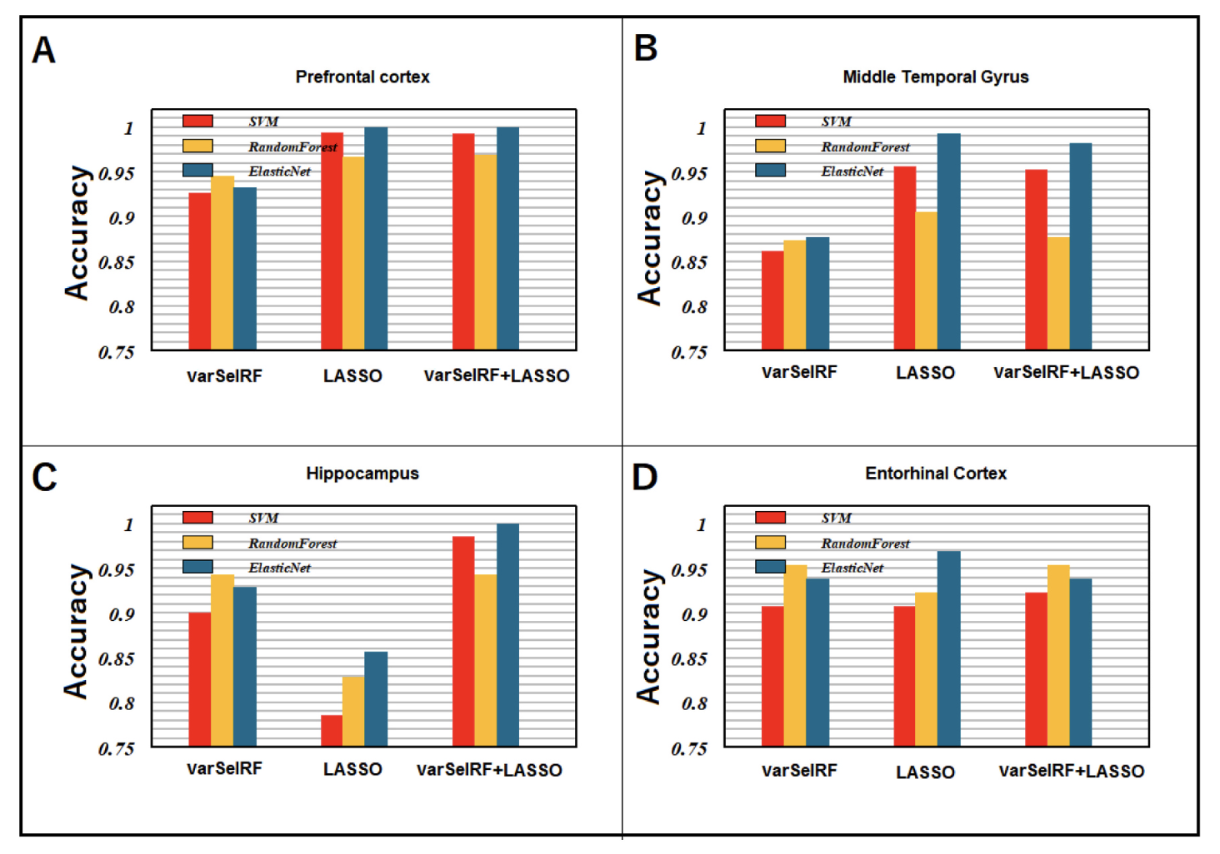

Slide 44
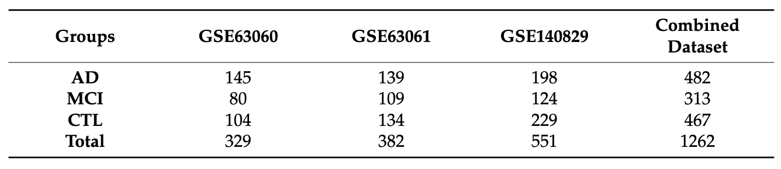
Prediction of Alzheimer’s Disease by a Novel Image-Based Representation of Gene Expression, H. Kalkan, U. M. Akkaya, G. Inal-Gültekin, and A. M. Sanchez-Perez – MDPI, Genes, vol. 13, no. 8, p. 1406, Aug. 2022
This study aims to generate a reliable artificial model capable of detecting the high risk of AD, based on gene expression array collected from blood samples.
Single dimension gene expression is converted into a discriminative 2D image which is then used by the CNN model for classification.
Study is conducted using 11,618 common genes expression values which are categorized based on Fisher distance.
Proposed method of 2D conversion of gene expression was found to have a unique advantage for improving accuracy and can be easily transferred to the clinic to drastically improve AD early detection.

Slide 45
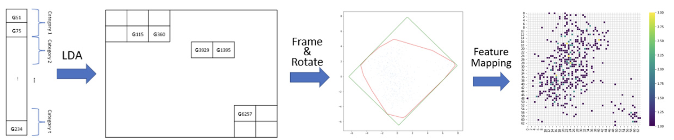
Method:
Dataset and Data Preprocessing: datasets were extracted from NCBI, GSE63060, GSE63062 and GSE140829. All these datasets were combined, and values were min-max normalized.
Image-Based Representation of mRNA Expression: LASSO regression is used to eliminate irrelevant genes for AD. Linear discriminant analysis is used to determine the position of gene in the 2D space.

Slide 46
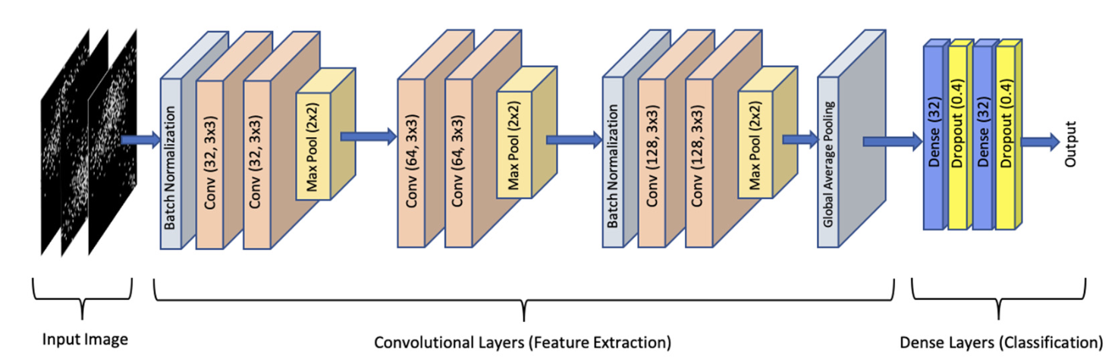
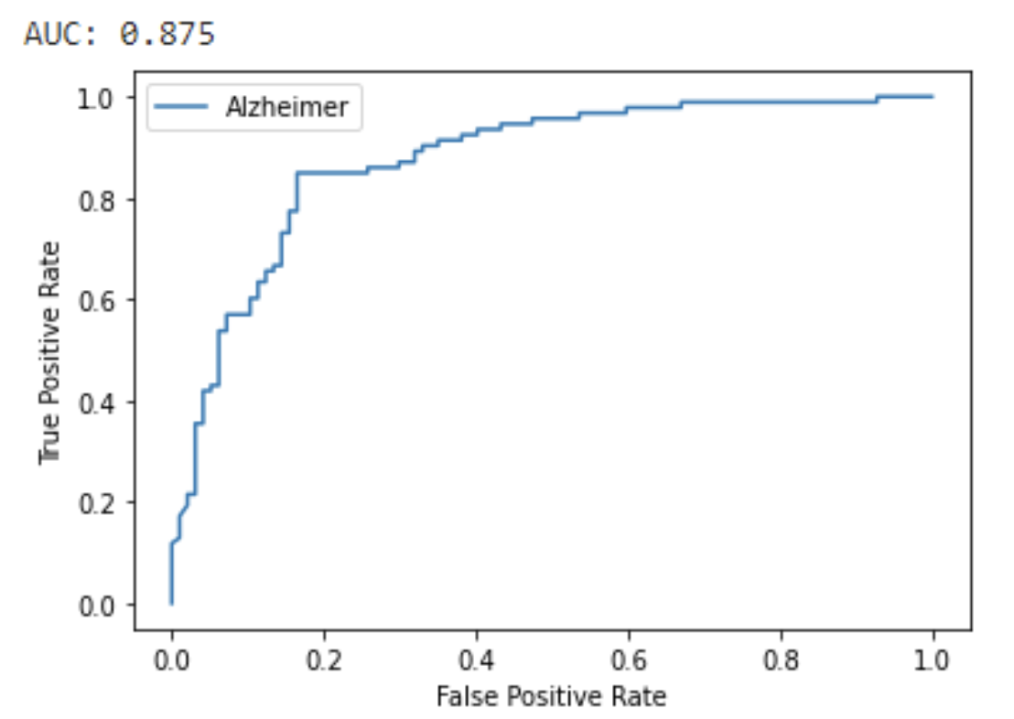
Classification:
Done using CNN with following configurations
Results:
LDA based image imaging along with CNN observed to performing well compared to the existing method like LASSO+SVM, tSNE + CNN.

Slide 47
3-D CNN-based Multichannel Contrastive Learning for Alzheimer’s Disease Automatic Diagnosis, J. Li, Y. Wei, C. Wang, Q. Hu, Y. Liu and L. Xu – IEEE Transactions on Instrumentation and Measurement, vol. 71, pp. 1-11, 2022
Study aims to propose an automatic classification method of AD versus normal control (NC) and mild cognitive impairment (MCI) based on the magnetic resonance images (MRI).
Complete 3D channel form the MRI images is used as the input, which can obtain image information to the greatest extent.
Contrastive learning strategy based on multiple data transformation methods are used to combine supervised classification loss with the unsupervised contrastive loss.
Results were verified used the samples collected from ADNI dataset which showed the model’s effectiveness to classify AD and MCI samples.
Multichannel contrastive learning strategy greatly improved classification accuracy and generalization ability of the network.

Slide 48
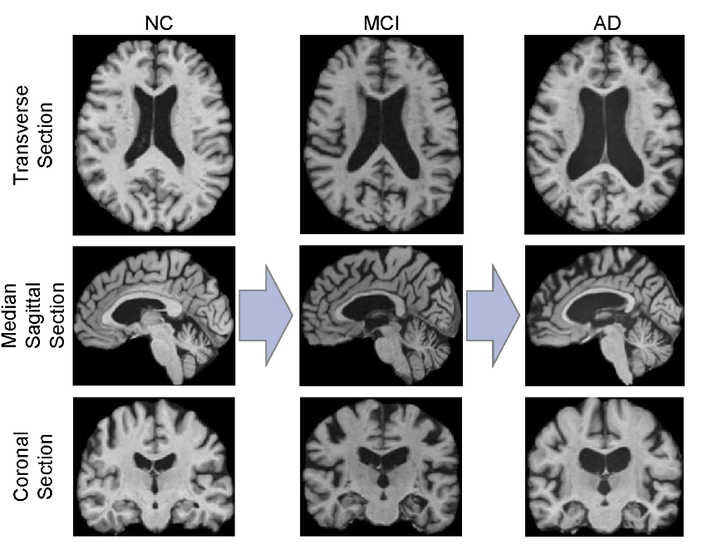
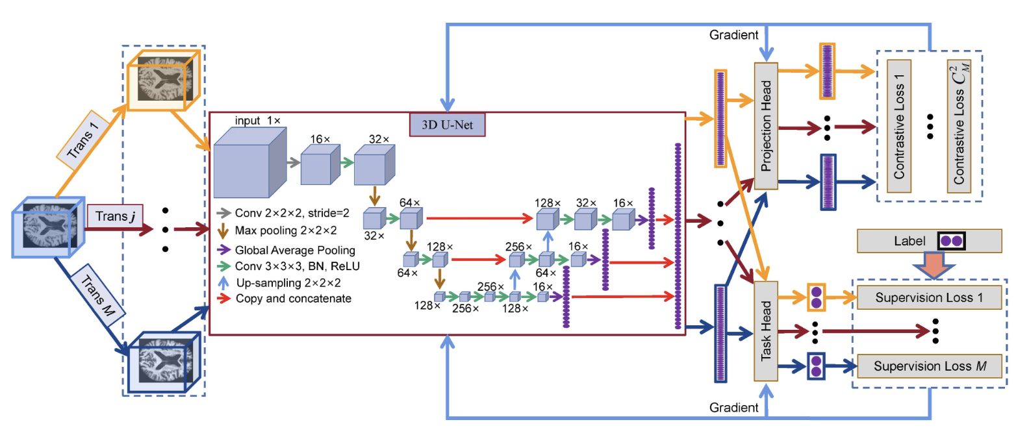
Self-Supervised Contrastive Learning:
Was proposed to learn visual features from large-scale unlabeled images or videos by constructing pretext task without using human annotations.
Constructs positive samples and negative samples through two different data transformation methods.
Data Preprocessing:
Resample
Skull Stripping
Intensity correction
Clip
Framework:

Slide 49
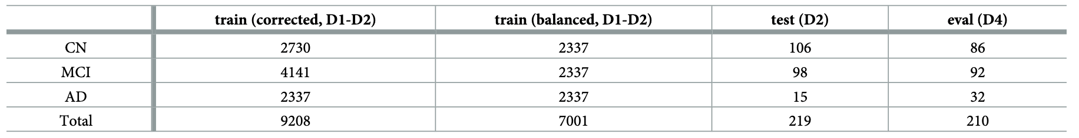
Explainable AI toward understanding the performance of the top three TADPOLE Challenge methods in the forecast of Alzheimer’s disease diagnosis, Hernandez M, Ramon-Julvez U, Ferraz F, with the ADNI Consortium (2022) - PLOS ONE 17(5): e0264695 - 2022
TADPOLE (The Alzheimer’s Disease Prediction of Longitudinal Evolution)
Objective of the study was the identification of the most predictive data, features and methods for the progression of subjects at the risk of developing Alzheimer’s.
Tree-based ensemble methods such as Gradient Boosting and Random Forest were explored.
TADPOLE focused on improving performance rather than focusing on the interpretability.
Provide plausible explanations on why the model achieve high accuracy.

Slide 50
Method:
Dataset: The longitudinal dataset was extracted from TADPOLE challenge organized (D1, D2), which contained a total of 12734 samples.
Preprocessing: None done as the data was already normalized.
Classification methods:
Gradient Boosting (XGB)
Random Forest (RF)
Support Vector Machines (SVM)
Evaluation metric: mAUC (multi-class area under the curve)
Explainable AI:
XGB: The importance measures how valuable each feature is in the construction of the boosted decision trees.
RF: The importance is computed from the mean and standard deviation of the accumulation of the impurity decrease within each tree.

Slide 51
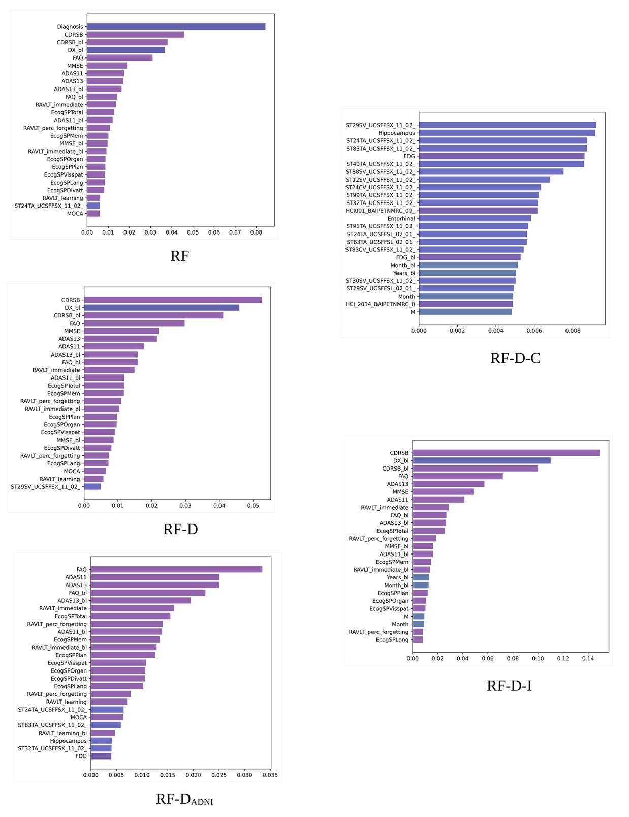
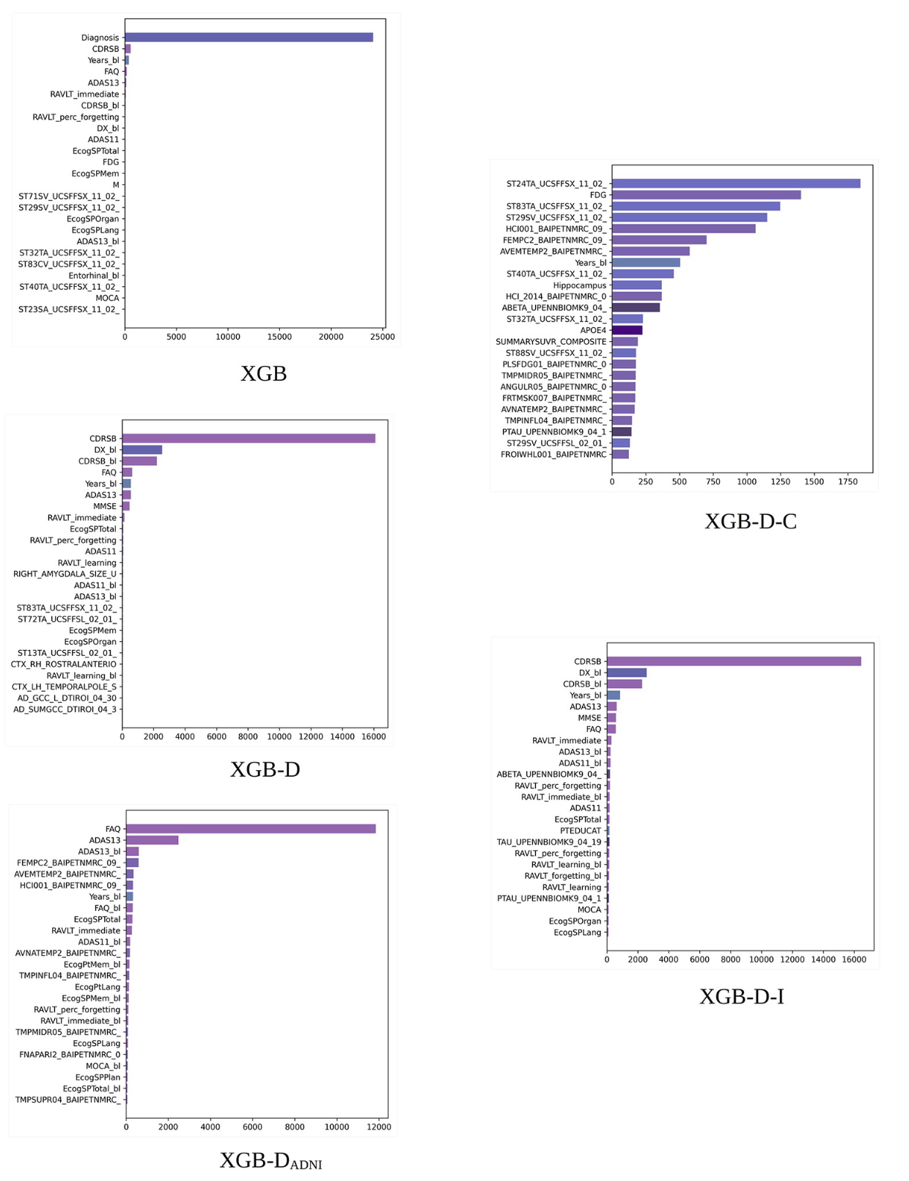

Slide 52
Computational Modelling of Dementia Prediction Using Deep Neural Network: Analysis on OASIS Dataset, S. Basheer, S. Bhatia and S. B. Sakri, IEEE Access, vol. 9, pp. 42449-42462, 2021
This paper intends to develop the novel algorithm by proposing changes in the designing of capsule network for best prediction results and making the model computationally efficient.
The research is conducted on the Open Access Series of Imaging Studies (OASIS) dataset with dimensions (373 X 15) to diagnose the labels into two groups, as demented and non-demented.
In-depth research in identifying the importance of features, correlation study between factors and density of data showing status of factors by studying hierarchical examination of all the data points available using exploratory data analysis.
The claims have been validated by showing the correlation accuracy at several iterations and layers with an admissible accuracy of 92.39%. The model is compared with state-of-art deep learning classifiers taken as benchmarks using different performance metrics. The ablation study is conducted on the proposed model using OASIS dataset to justify the predictions of the model.

Slide 53
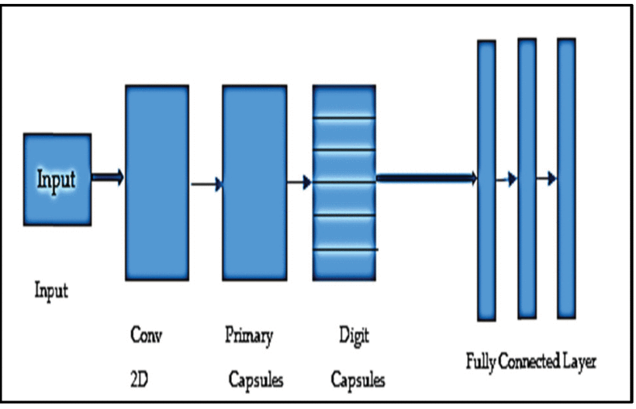
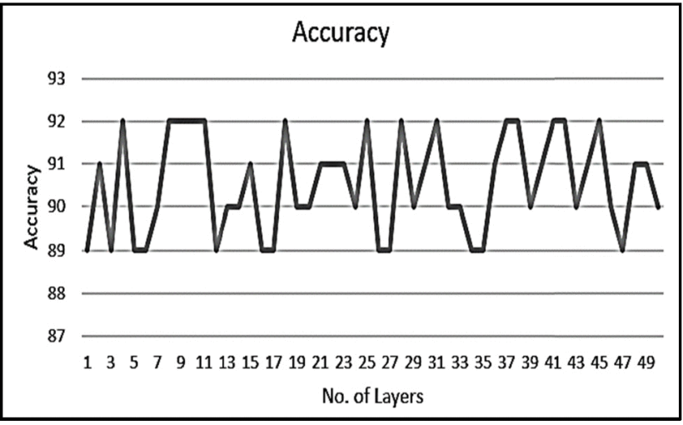
Method
Dataset: OASIS database (https://www.oasis-brains.org/).
The dataset consists of MRI and PET images of clinical patients collected over the period of 15 years. The study was done on longitudinal MRI dataset consisting of 150 subjects for exploratory data analysis.
CapNet Model:

Slide 54
Prediction of differentially expressed microRNAs in blood as potential biomarkers for Alzheimer’s disease by meta-analysis and adaptive boosting ensemble learning, Yuen, S.C., Liang, X., Zhu, H. et al – Springer Nature, Alz Res Therapy 13, 126 (2021)
Studies on DEmiRNAs and their dysregulation states were corroborated with one another by meta-analysis based on a random-effects model
DEmiRNAs identified by meta-analysis were collected as positive examples of miRNA–AD pairs for ABMDA ensemble learning
ABMDA identified similar DEmiRNAs according to a set of predefined criteria. The biological significance of all resulting DEmiRNAs was determined by their target genes according to pathway enrichment analyses.
The target genes common to both meta-analysis- and ABMDA-identified DEmiRNAs were collected to construct a network to investigate their biological functions.
This study identified 28 DEmiRNAs as potential AD biomarkers in blood, by meta-analysis and ABMDA ensemble learning in tandem.

Slide 55
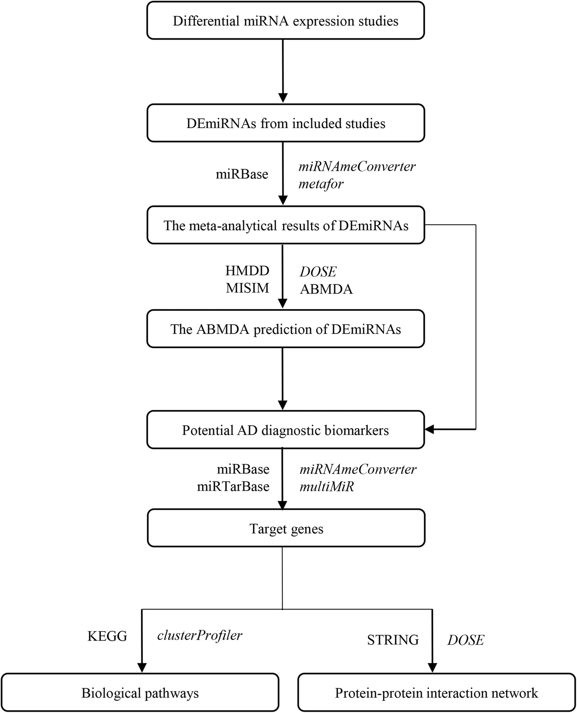
Method

Slide 56
Implementation
Dataset: GSE63060
Feature Extraction | Classification | Accuracy (Training Set) | Accuracy (Testing Set)
Chi Square | SVM Linear Kernel | 99.67% | 77%
Chi Square | SVM Gaussian Kernel | 98.85 | 84%
Chi Square | DNN (64, 128, 128, 2) | 97.13% | 77.33%
Chi Square | DNN (6, 4, 4, 2) | 93.68% | 89.33%

Slide 57
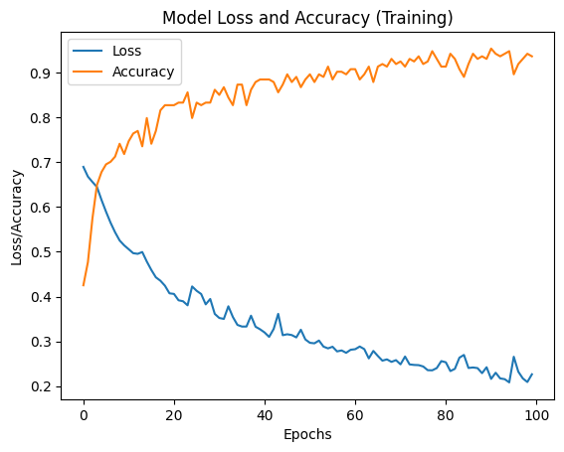


Slide 58


Slide 59


Slide 60
References
[1] Nandi, A et al, “Global and regional projections of the economic burden of Alzheimer's disease and related dementias from 2019 to 2050: A value of statistical life approach”, EClinicalMedicine - The Lancet Discovery Science, Volume 51, 101580, 2022. https://doi.org/10.1016/j.eclinm.2022.101580.
[2] Lee, T., Lee, H. Prediction of Alzheimer’s disease using blood gene expression data. Sci Rep 10, 3485, 2020. https://doi.org/10.1038/s41598-020-60595-1.
[3] M. S. Kamal, A. Northcote, L. Chowdhury, N. Dey, R. G. Crespo and E. Herrera-Viedma, "Alzheimer’s Patient Analysis Using Image and Gene Expression Data and Explainable-AI to Present Associated Genes," in IEEE Transactions on Instrumentation and Measurement, vol. 70, pp. 1-7, 2021, Art no. 2513107, doi: 10.1109/TIM.2021.3107056.
[4] Mahendran N, P M DRV. A deep learning framework with an embedded-based feature selection approach for the early detection of the Alzheimer's disease. Comput Biol Med. 2022 Feb; 141:105056. doi: 10.1016/j.compbiomed.2021.105056. Epub 2021 Nov 22. PMID: 34839903.
[5] S. Khanal, J. Chen, N. Jacobs, and A. -L. Lin, "Alzheimer’s Disease Classification Using Genetic Data," 2021 IEEE International Conference on Bioinformatics and Biomedicine (BIBM), 2021, pp. 2245-2252, doi: 10.1109/BIBM52615.2021.9669730.
[6] El-Gawady, A.; Makhlouf, M.A.; Tawfik, B.S.; Nassar, H. Machine Learning Framework for the Prediction of Alzheimer’s Disease Using Gene Expression Data Based on Efficient Gene Selection. Symmetry 2022, 14, 491. https://doi.org/10.3390/sym14030491.
[7] S. Perera, K. Hewage, C. Gunarathne, R. Navarathna, D. Herath and R. G. Ragel, "Detection of Novel Biomarker Genes of Alzheimer’s Disease Using Gene Expression Data," 2020 Moratuwa Engineering Research Conference (MERCon), 2020, pp. 1-6, doi: 10.1109/MERCon50084.2020.9185336.
[8] C. Park, J. Ha, and S. Park, "Prediction of Alzheimer's disease based on deep neural network by integrating gene expression and DNA methylation dataset," Expert Systems with Applications, vol. 140, pp. 112873, 2020, doi: 10.1016/j.eswa.2019.112873.
[9] H. M. AL-Bermany and S. Z. AL-Rashid, "Microarray Gene Expression Data for Detection Alzheimer’s Disease Using k-means and Deep Learning," 2021 7th International Engineering Conference “Research & Innovation amid Global Pandemic" (IEC), 2021, pp. 13-19, doi: 10.1109/IEC52205.2021.9476128.
[10] A. Sharma, P. Dey, "A Machine Learning Approach to Unmask Novel Gene Signatures and Prediction of Alzheimer's Disease Within Different Brain Regions," Genomics, vol. 113, no. 4, pp. 1778-1789, Apr. 2021, doi: 10.1016/j.ygeno.2021.04.028.
[11] Kalkan H, Akkaya UM, Inal-Gültekin G, Sanchez-Perez AM. Prediction of Alzheimer's Disease by a Novel Image-Based Representation of Gene Expression. Genes (Basel). 2022 Aug 8;13(8):1406. doi: 10.3390/genes13081406. PMID: 36011317; PMCID: PMC9407775.
[12] D. Sun, H. Peng and Z. Wu, "Establishment and Analysis of a Combined Diagnostic Model of Alzheimer's Disease with Random Forest and Artificial Neural Network," Frontiers in Aging Neuroscience, 2022. Available: https://www.proquest.com/scholarly-journals/establishment-analysis-combined-diagnostic-model/docview/2682564611/se-2. DOI: https://doi.org/10.3389/fnagi.2022.921906.

Slide 61
References
[13] Yuen, S.C., Liang, X., Zhu, H., Jia, Y., and Leung, S.W. "Prediction of differentially expressed microRNAs in blood as potential biomarkers for Alzheimer's disease by meta-analysis and adaptive boosting ensemble learning." Alzheimer's Research & Therapy, vol. 13, no. 1, 2021, p. 126. doi: 10.1186/s13195-021-00862-z.
[14] S. Pavalarajan, B. A. Kumar, S. S. Hammed, K. Haripriya, C. Preethi and T. Mohanraj, "Detection of Alzheimer's disease at Early Stage using Machine Learning," 2022 International Conference on Advanced Computing Technologies and Applications (ICACTA), Coimbatore, India, 2022, pp. 1-5, doi: 10.1109/ICACTA54488.2022.9752827.
[15] S. S. Rajeswari and M. Nair, "A Transfer Learning Approach for Predicting Alzheimer's Disease," 2021 4th Biennial International Conference on Nascent Technologies in Engineering (ICNTE), NaviMumbai, India, 2021, pp. 1-5, doi: 10.1109/ICNTE51185.2021.9487746.
[16] J. Li, Y. Wei, C. Wang, Q. Hu, Y. Liu and L. Xu, "3-D CNN-Based Multichannel Contrastive Learning for Alzheimer’s Disease Automatic Diagnosis," in IEEE Transactions on Instrumentation and Measurement, vol. 71, pp. 1-11, 2022, Art no. 5008411, doi: 10.1109/TIM.2022.3162265.
[17] S. Basheer, S. Bhatia and S. B. Sakri, "Computational Modelling of Dementia Prediction Using Deep Neural Network: Analysis on OASIS Dataset," in IEEE Access, vol. 9, pp. 42449-42462, 2021, doi: 10.1109/ACCESS.2021.3066213.
[18] G. Chutani, H. Bohra, D. Diwan and N. Garg, "Improved Alzheimer Detection using Image Enhancement Techniques and Transfer Learning," 2022 3rd International Conference for Emerging Technology (INCET), Belgaum, India, 2022, pp. 1-6, doi: 10.1109/INCET54531.2022.9824008.
[19] D. Chaihtra and S. Vijaya Shetty, "Alzheimer’s Disease Detection from Brain MRI Data using Deep Learning Techniques," 2021 2nd Global Conference for Advancement in Technology (GCAT), Bangalore, India, 2021, pp. 1-5, doi: 10.1109/GCAT52182.2021.9587756.
[20] U. R. K, S. S. S, U. M. G and V. B. C, "Binary Classification of Alzheimer's disease using MRI images and Support Vector Machine," 2021 IEEE Mysore Sub Section International Conference (MysuruCon), Hassan, India, 2021, pp. 423-426, doi: 10.1109/MysuruCon52639.2021.9641661.
[21] S. Buyrukoğlu, "Improvement of Machine Learning Models’ Performances based on Ensemble Learning for the detection of Alzheimer Disease," 2021 6th International Conference on Computer Science and Engineering (UBMK), Ankara, Turkey, 2021, pp. 102-106, doi: 10.1109/UBMK52708.2021.9558994.

